Slide 1
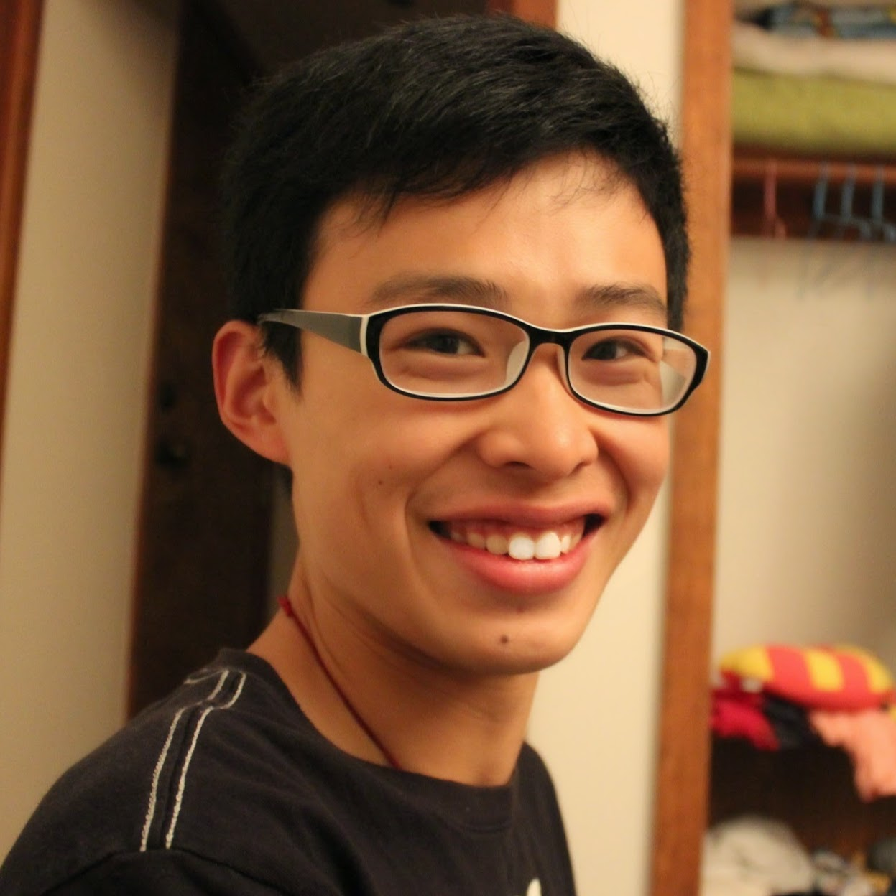
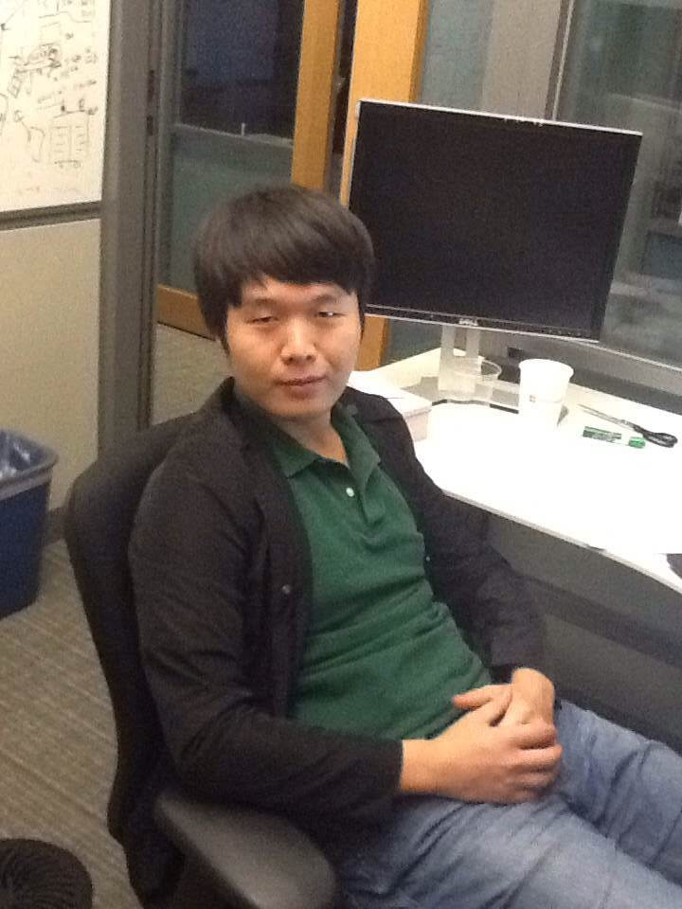
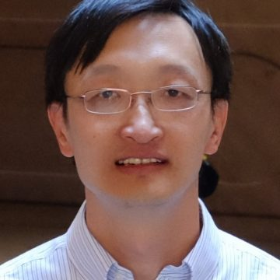
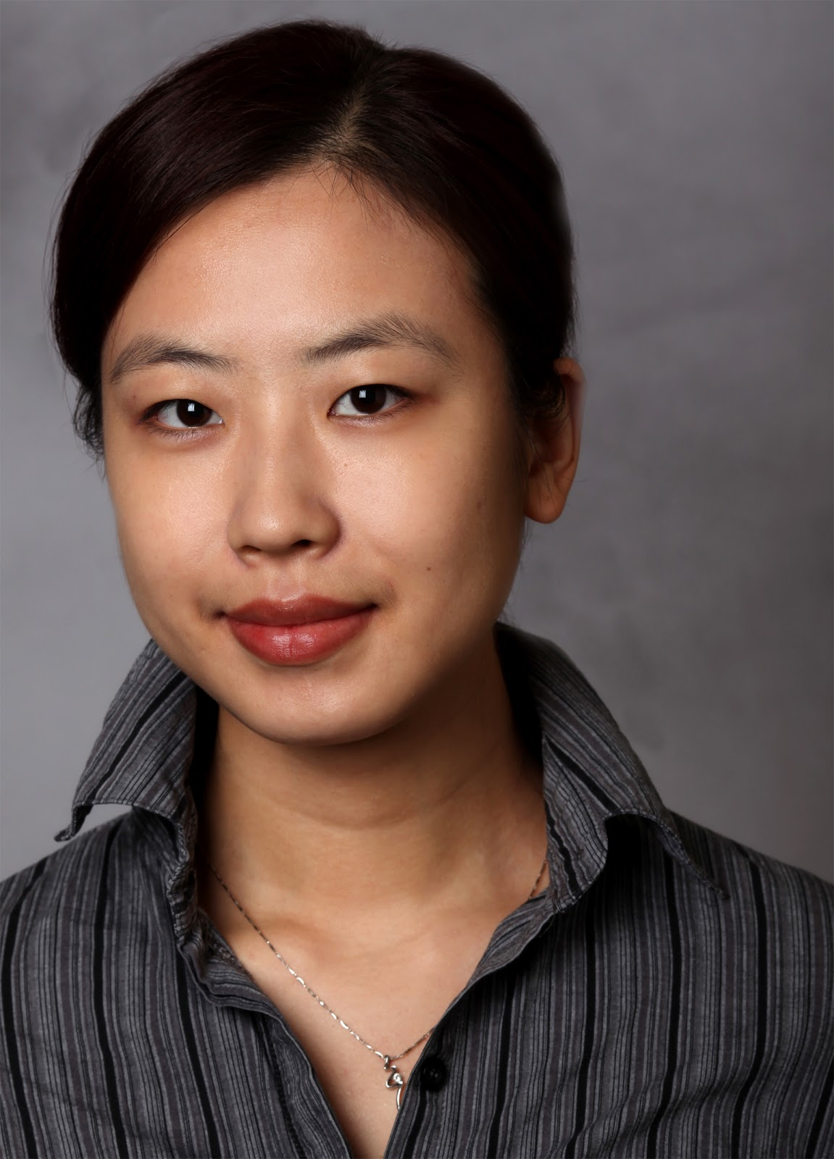
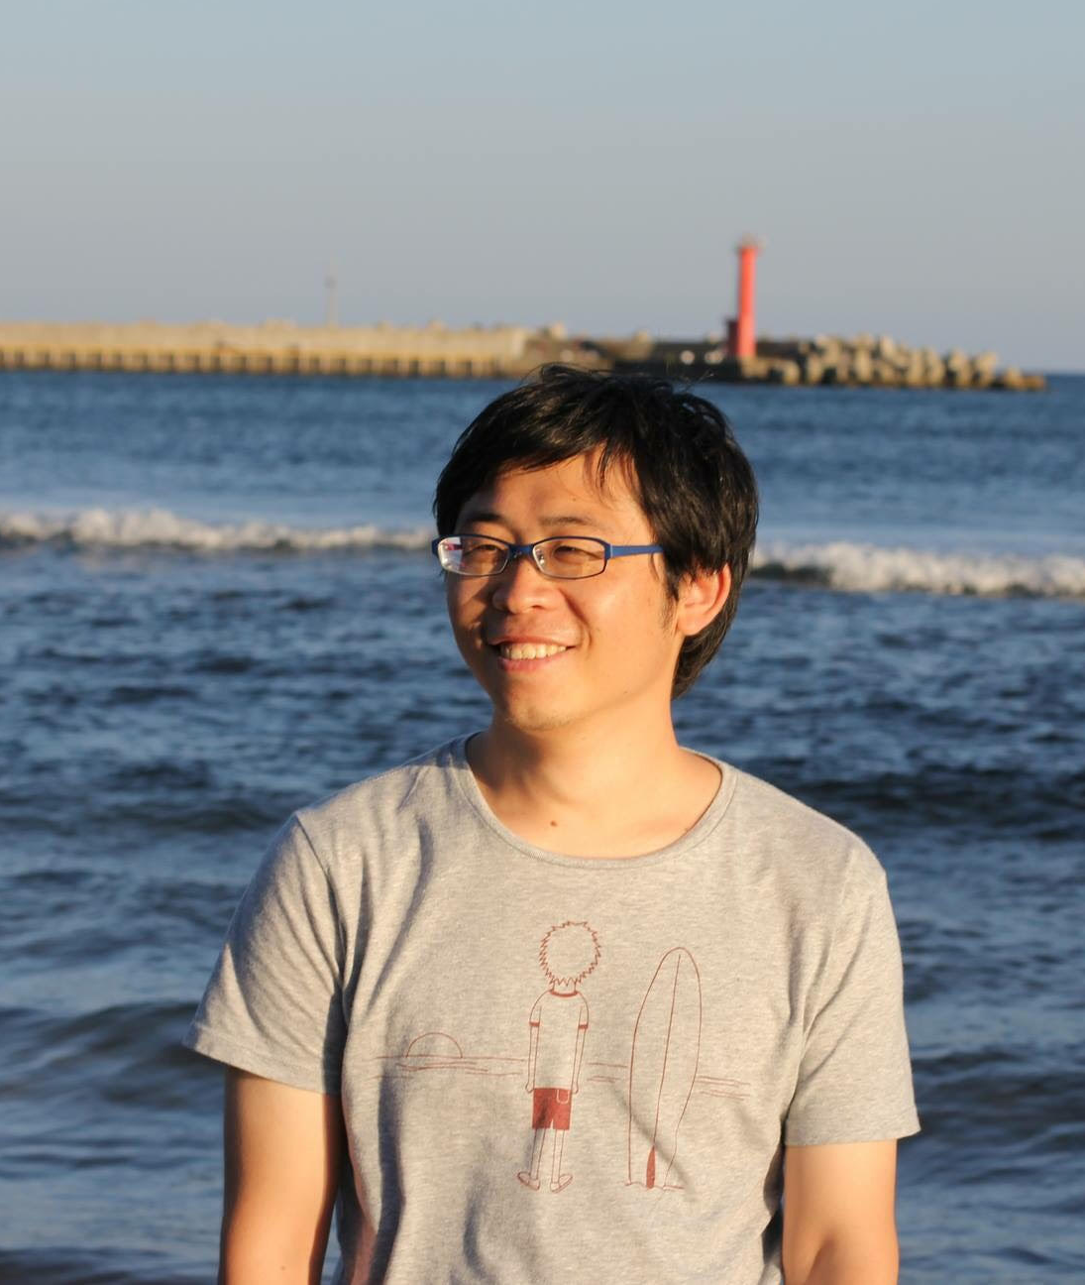
Language-Based Image Editing with Recurrent Attentive Models
Jianbo Chen*, Yelong Shen†, Jianfeng Gao†, Jingjing Liu†, Xiaodong Liu†
University of California, Berkeley* and Microsoft Research†

Slide 2
Problem: Language-Based Image Editing
Given a source image (a sketch, a grayscale image or a natural image), generate a target image based on natural language instructions.
Potential Applications:
Computer-Aided Design (CAD)
Virtual Reality (VR)

Slide 3
Model: Recurrent Attentive-Fusion Module

Slide 4
Image Encoder

Slide 5
Language Encoder

Slide 6
Recurrent Attentive-Fusion Module

Slide 7
Recurrent Attentive-Fusion Module

Slide 8
Recurrent Attentive-Fusion Module

Slide 9
Image Decoder

Slide 10
Use the Gumbel trick for training.

Slide 11
Experiments
CoSaL
ReferIt [1] (Omitted)
Oxford-102 Flower [2, 3]
[1] Kazemzadeh, Sahar, et al. Referitgame: Referring to objects in photographs of natural scenes. Proceedings of the 2014 conference on empirical methods in natural language processing (EMNLP). 2014.
[2] Nilsback, M-E. and Zisserman, A. Automated flower classification over a large number of classes Proceedings of the Indian Conference on Computer Vision, Graphics and Image Processing. 2008.
[3] Reed, Scott, et al. Generative Adversarial Text to Image Synthesis. International Conference on Machine Learning (ICML). 2016.

Slide 12
CoSaL (Colorizing Shapes with Artificial Language)

Slide 13
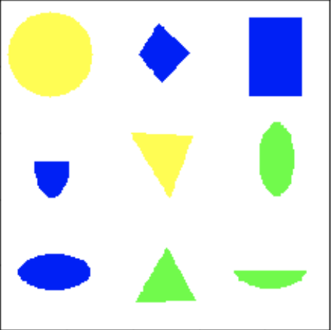
Task
Input Image:
Output Image:
Input Texts:
The color of the shape above triangle is yellow.
The triangle is light-green.
The color of the shape at the right of the diamond is blue.
…...

Slide 14
Metric and Results:
Metric: average IoU over nine shapes and the background.

Slide 15
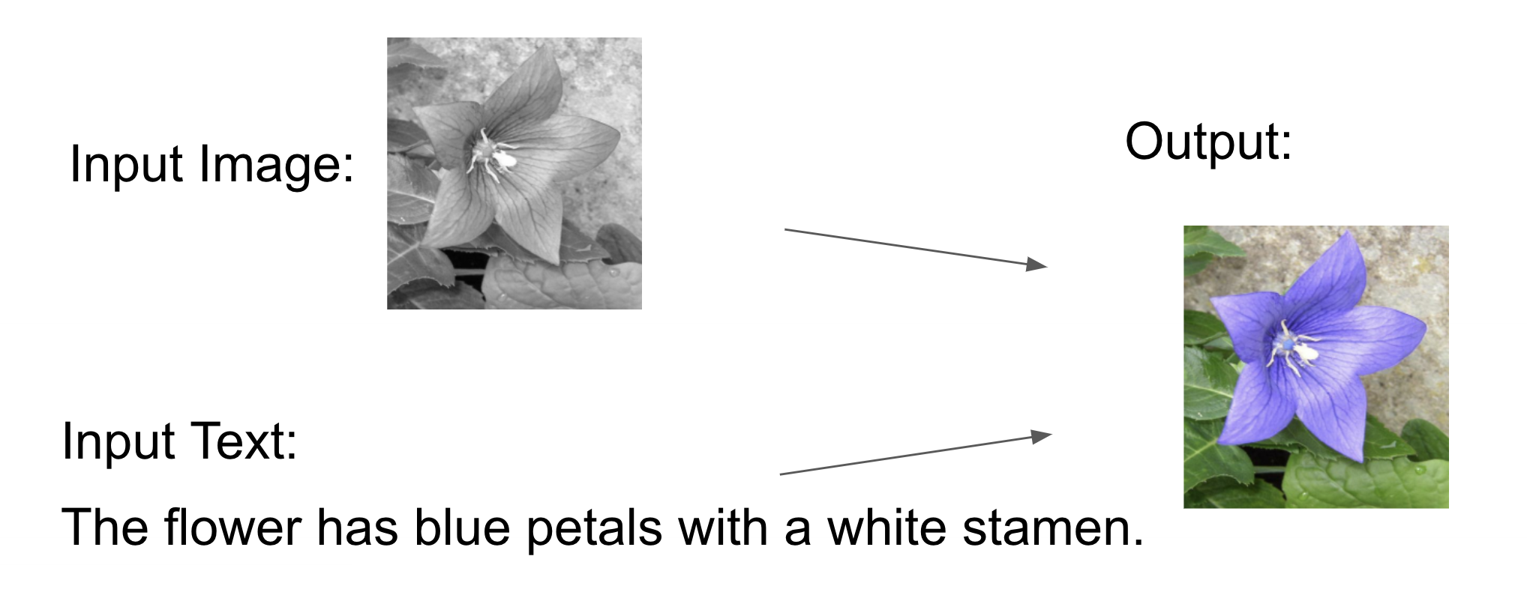
Oxford-102 Flower
Around 8k images from 102 flower categories.
Each image has five textual descriptions.
Inputs: a grayscale flower image, and a text description.
Output: Colorized image based on the text description.

Slide 16
Results
Consistency: Humans rate the consistency of images and their corresponding captions between 0 and 1.
Quality: Humans rate the quality of images without text descriptions between 0 and 1.
[4]
[4] Isola, Phillip, et al. Image-To-Image Translation With Conditional Adversarial Networks. Proceedings of the IEEE Conference on Computer Vision and Pattern Recognition (CVPR). 2017.

Slide 17
Results with/without text inputs.
Original
Without Texts
With Texts

Slide 18
Results generated based on text input: “The flower is XXX”.
Original
White
Red
Orange
Yellow
Blue
Purple

Slide 19
Language-Based Image Editing with Recurrent Attentive Models
Jianbo Chen, Yelong Shen, Jianfeng Gao, Jingjing Liu, Xiaodong Liu

