Slide 1
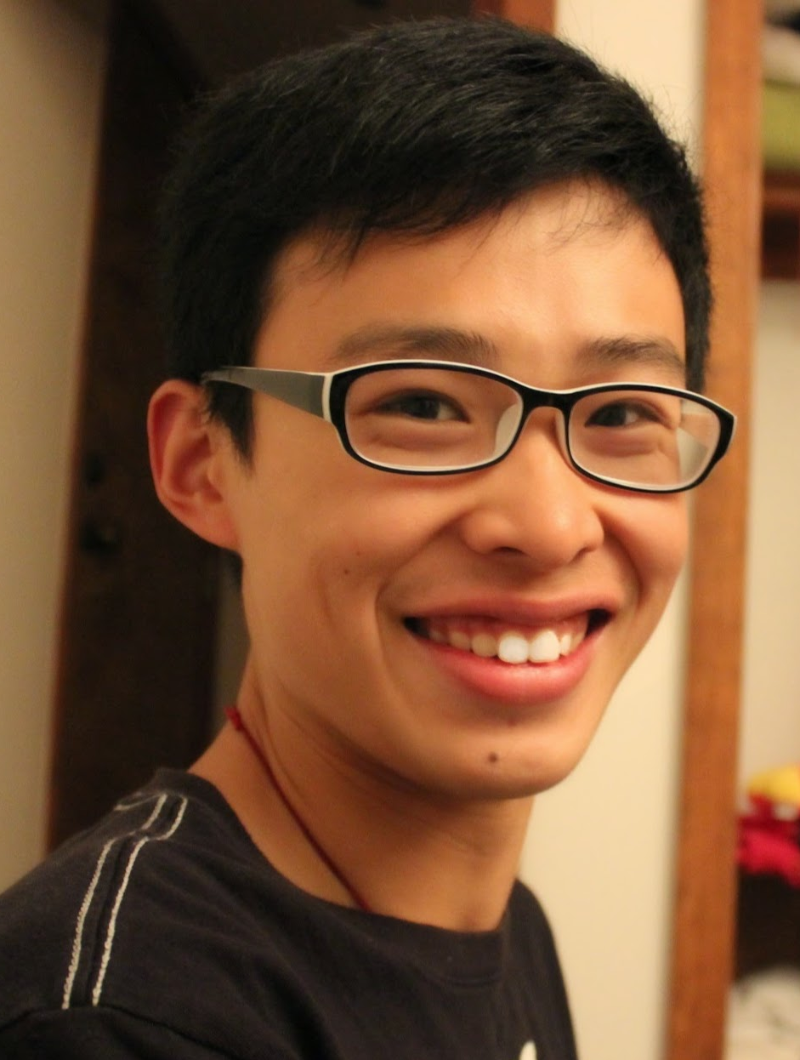
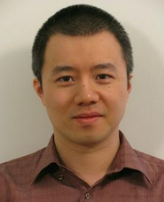
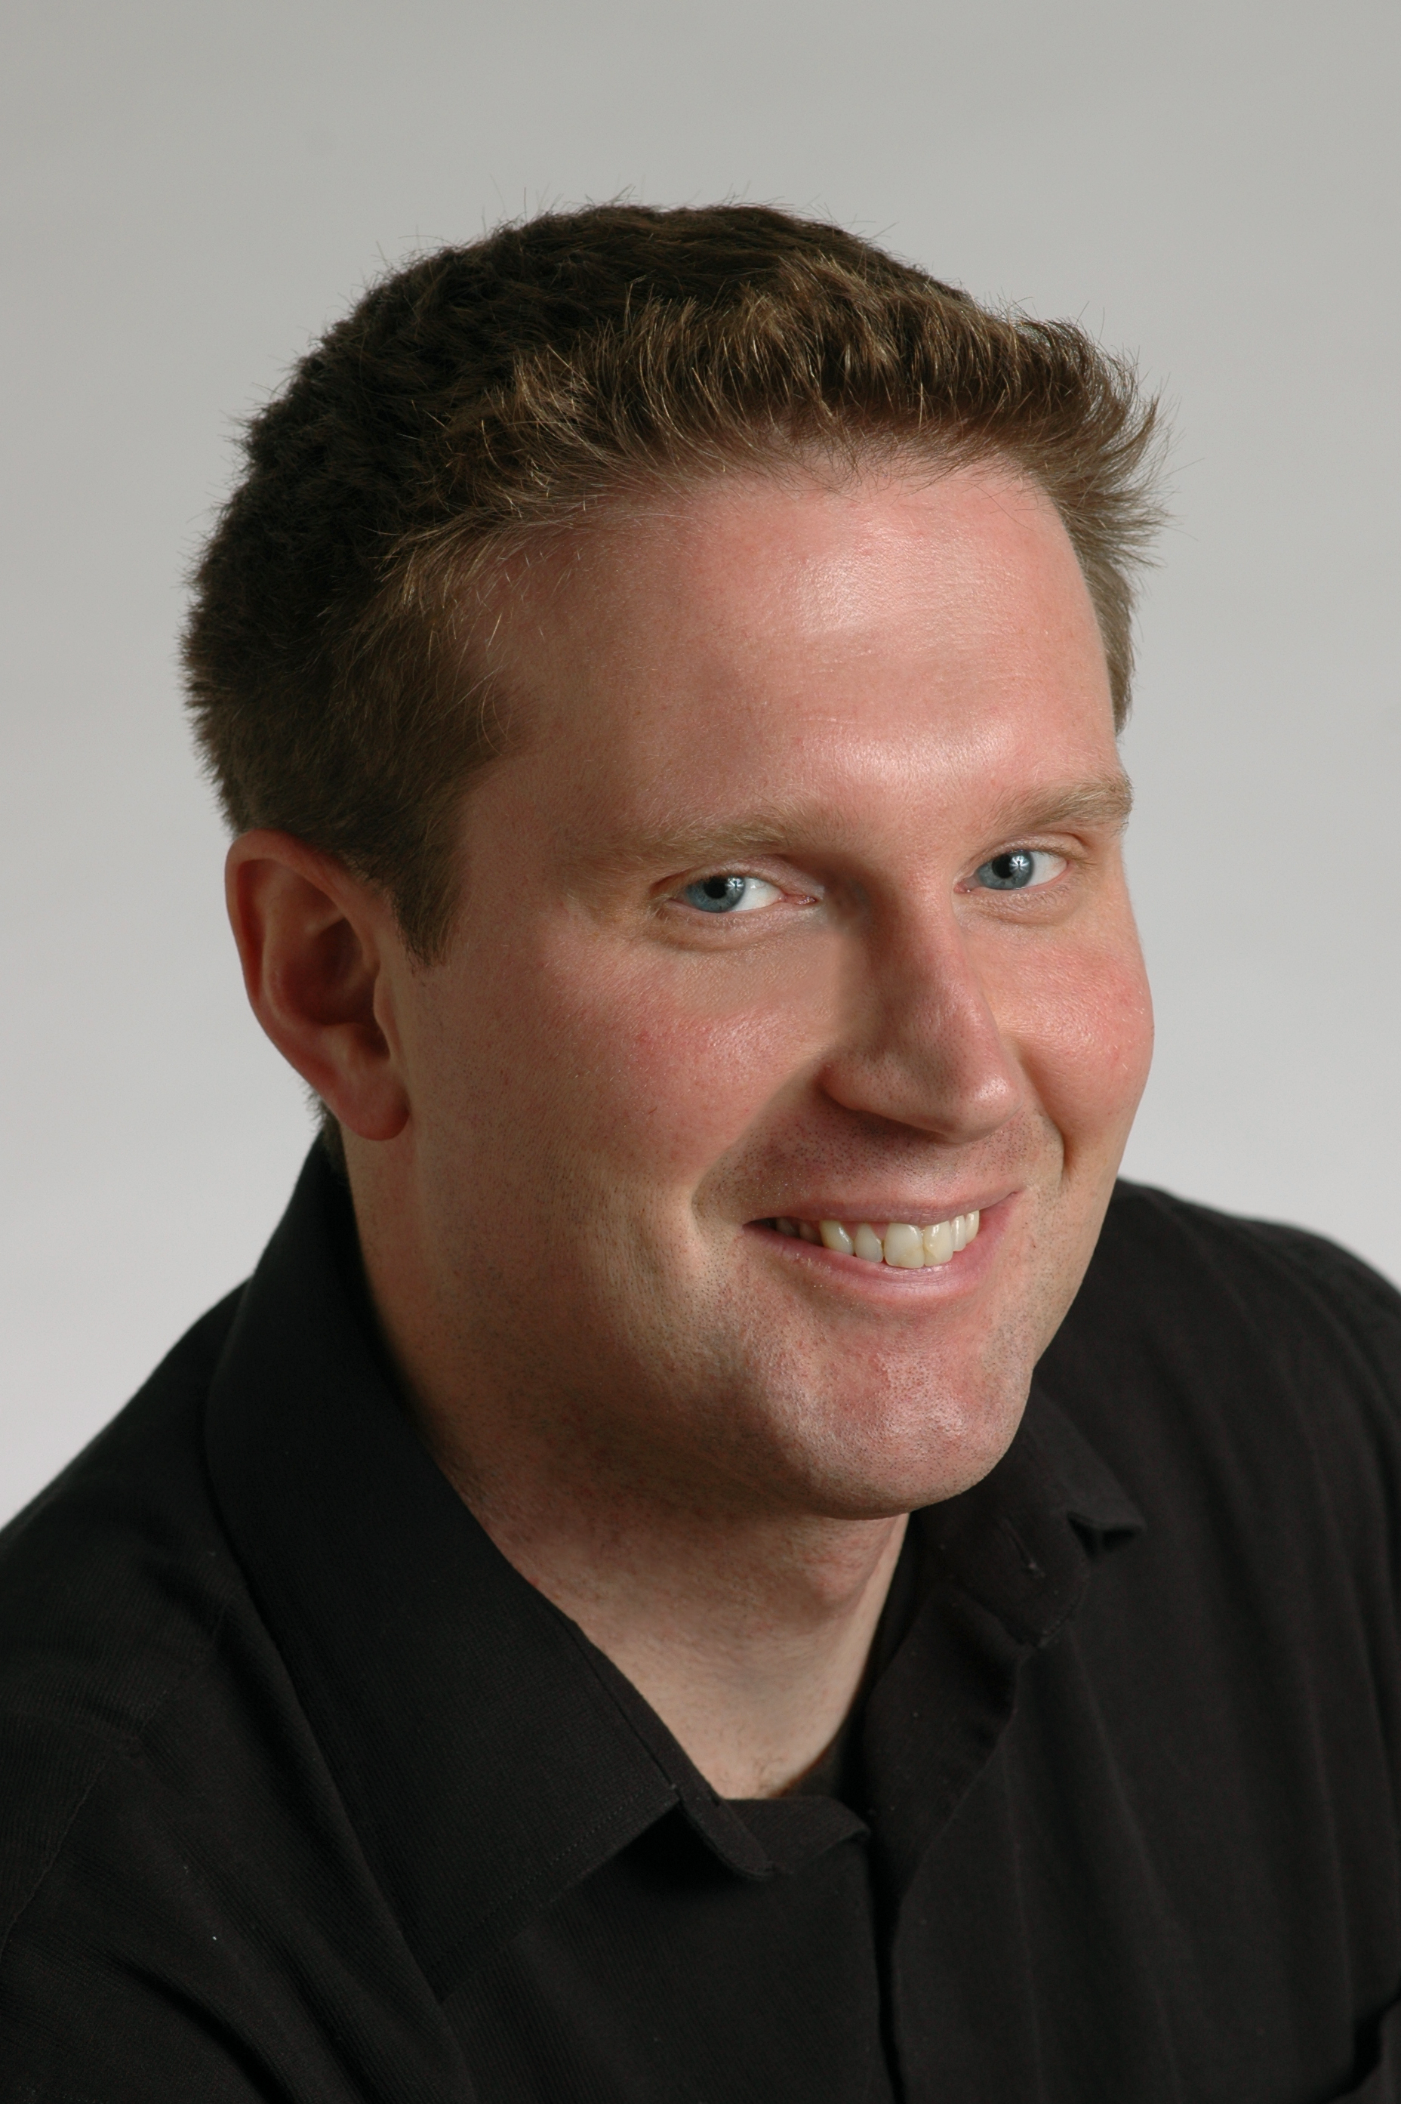
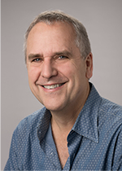
Learning to Explain:
An Information-theoretic Framework on
Model Interpretation
Jianbo Chen*, Le Song†✦, Martin J. Wainwright*◇ , Michael I. Jordan*
UC Berkeley*, Georgia Tech† , Ant Financial✦ and Voleon Group◇

Slide 2
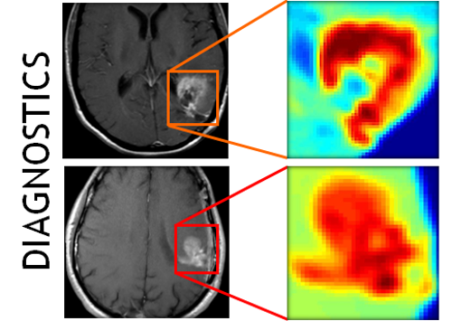


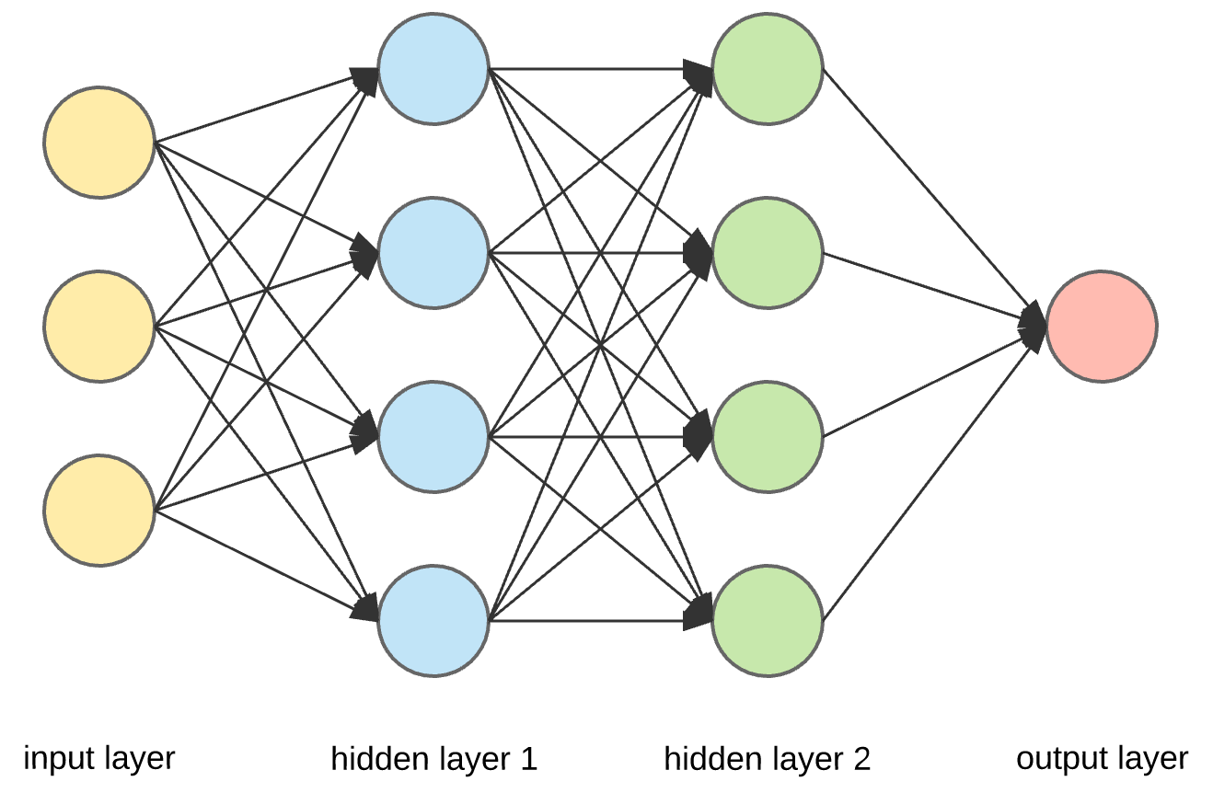
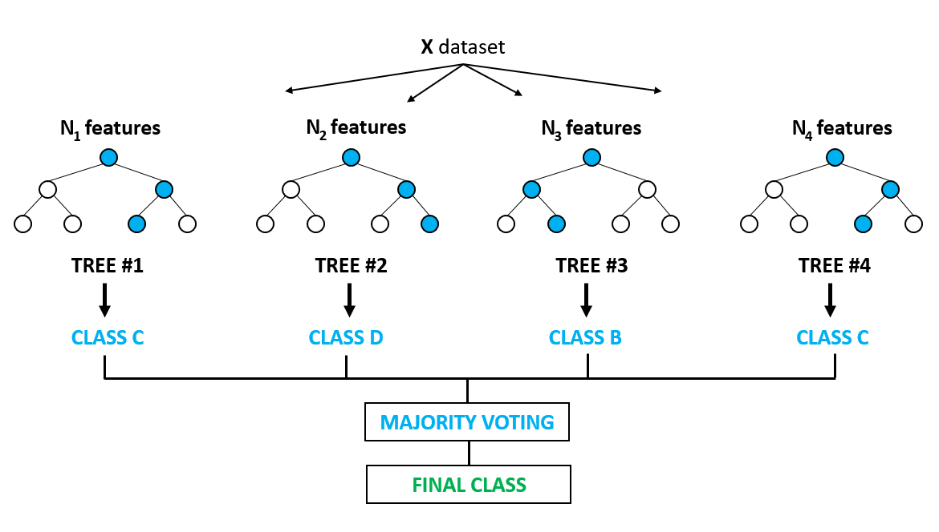
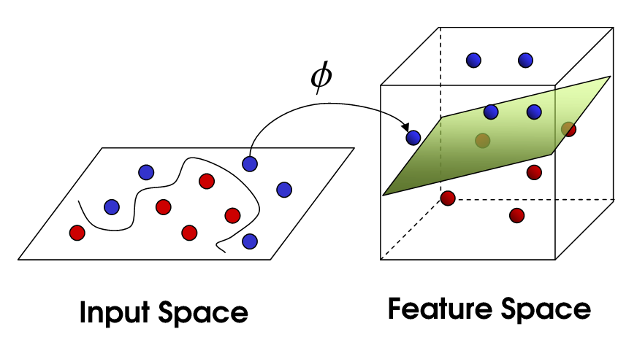
Motivations for Model Interpretation
Application of machine learning
  Medicine
  Financial markets
  Criminal justice
Complex models
  Deep neural networks
  Random forests
  Kernel methods

Slide 3
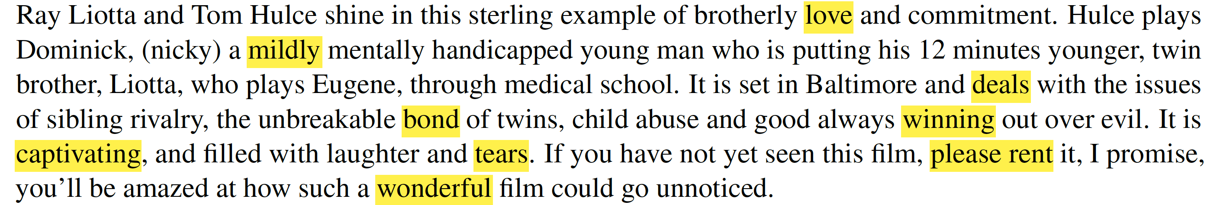
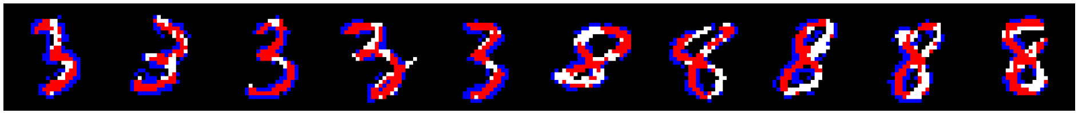
Instancewise Feature Selection
Inputs:
  A model
  A sample (A sentence, an image, etc.)
Outputs:
  Importance scores of each feature (word, pixel, etc.)
Feature importance is allowed to vary across instances.

Slide 4
Existing Work
Parzen window approximation + Gradient [Baehrens et al. , 2010]
Saliency map [Simonyan et al. , 2013]
LRP [Bach et al., 2015]
LIME [Ribeiro et al., 2016]
Kernel SHAP [Lundberg & Lee 2017]
Integrated Gradients [Sundararajan et al., 2017]
DeepLIFT [Shrikumar et al., 2017]
……

Slide 5
Properties
Training-required
Efficient
Additive
Model-agnostic

Slide 6
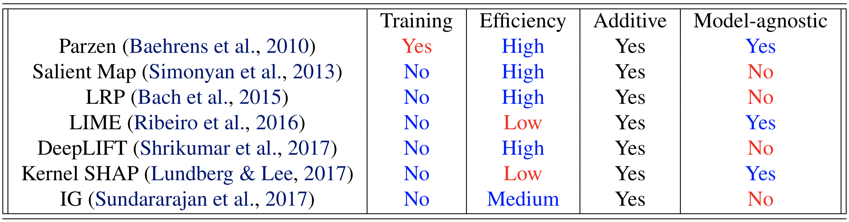
Properties of different methods

Slide 7
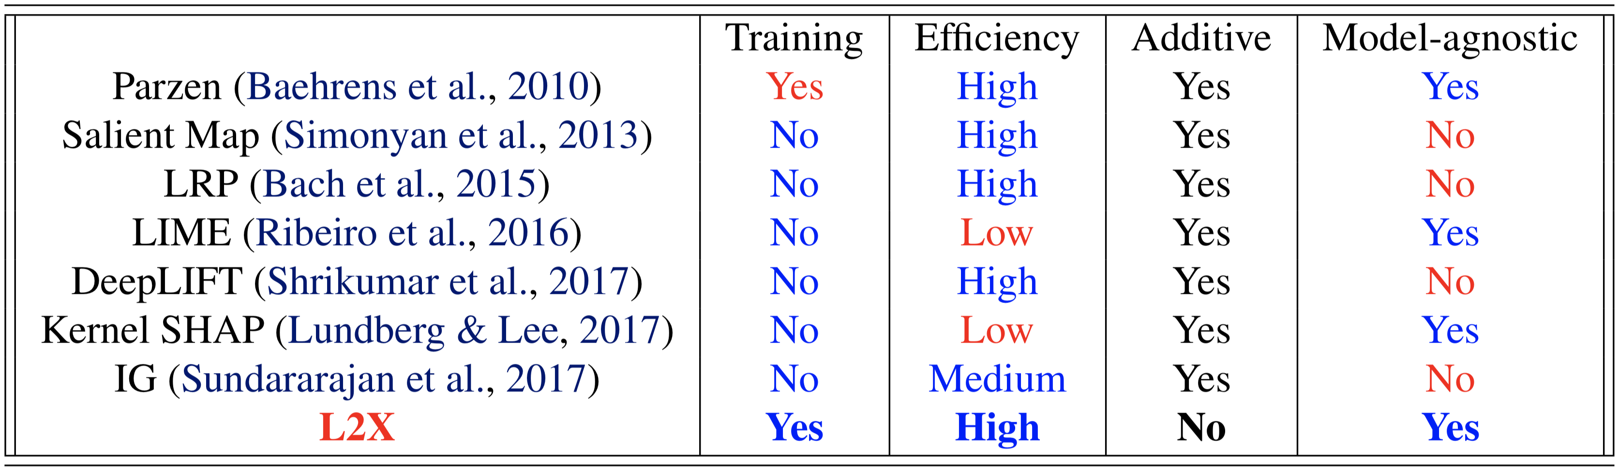
Our approach (L2X)
Globally learns a local explainer.
Removes the constraint of local feature additivity.

Slide 8
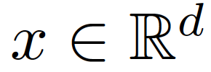
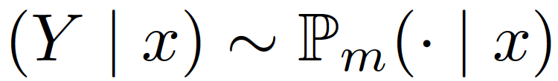

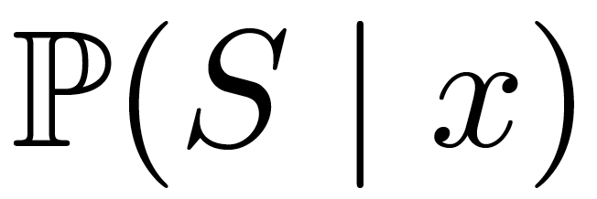
Some Notations
Input
Model
S: A feature subset of size k
Explainer :
X_{S}: The sub-vector of chosen features

Slide 9
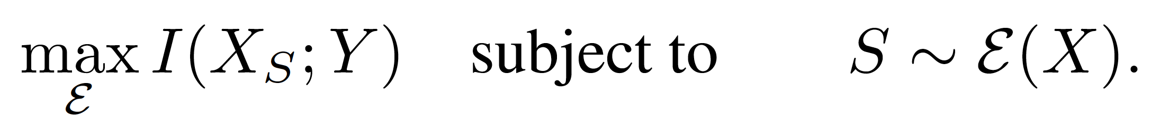
Our Framework
Maximize the mutual information between selected features and the response variable , over the explainer :

Slide 10
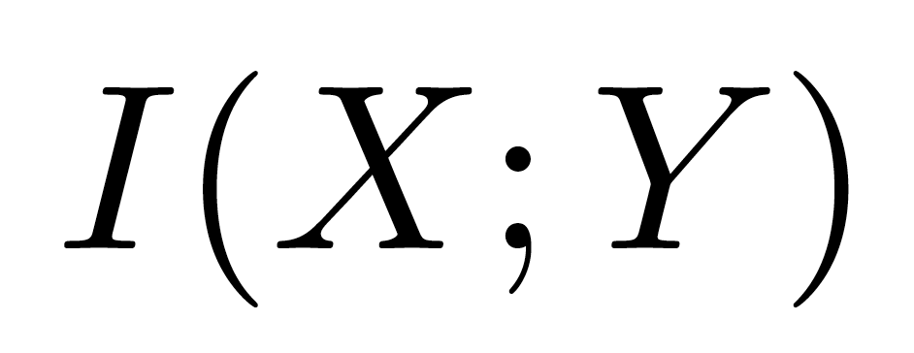
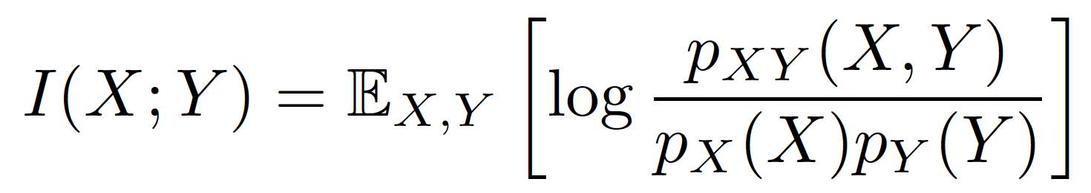
Mutual Information
A measure of dependence between two random variables.
How much the knowledge of X reduces the uncertainty about Y.
Definition:

Slide 11
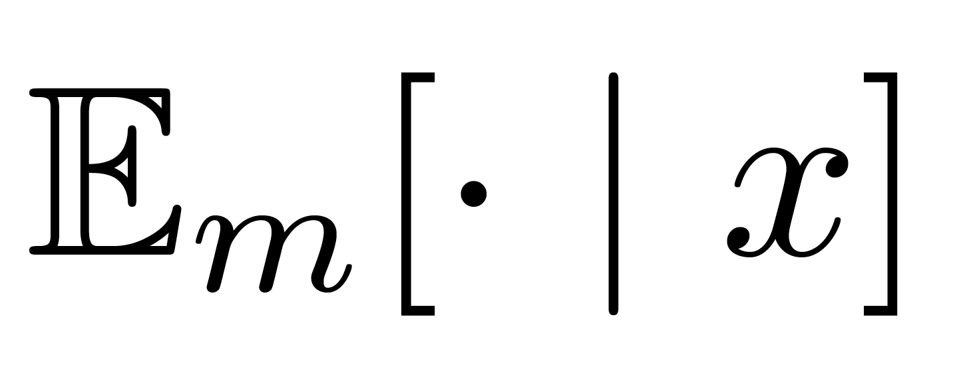
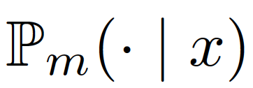
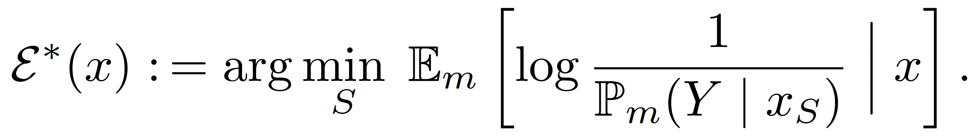
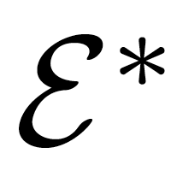
An Information-theoretic Interpretation
Theorem 1: Letting denote the expectation over ,,, define
Then is a global optimum of the following problem:

Slide 12
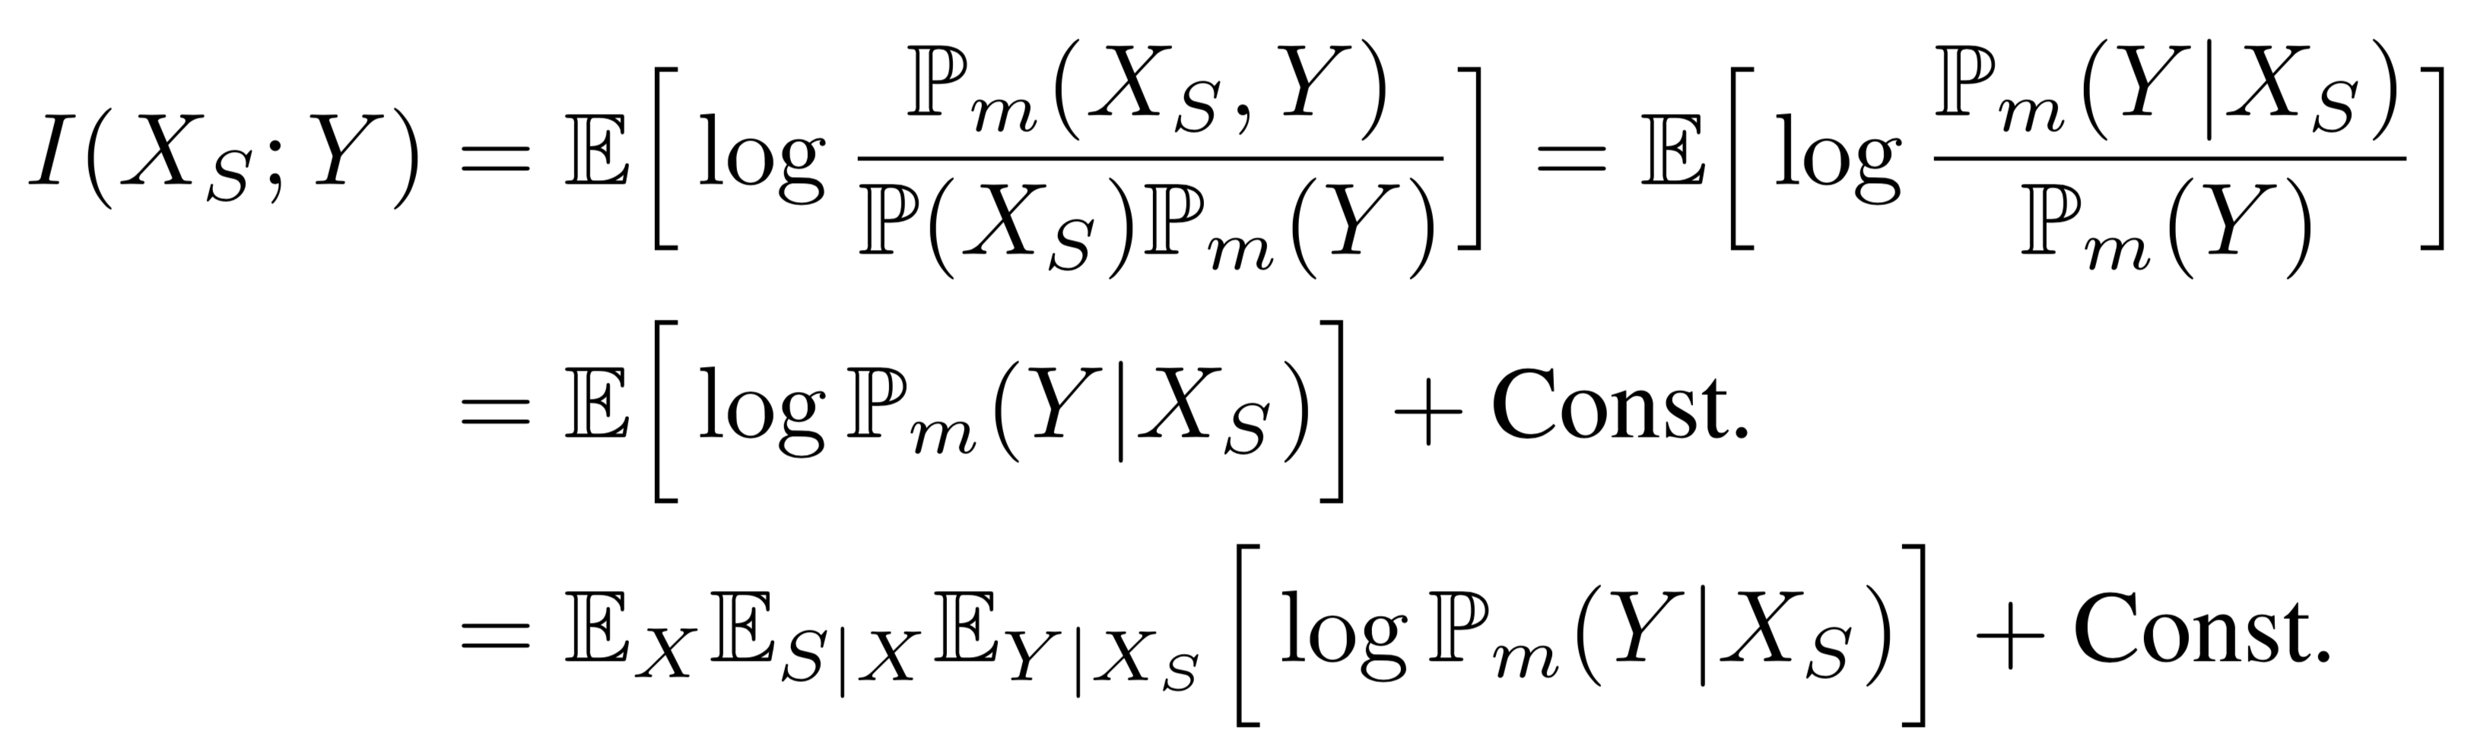
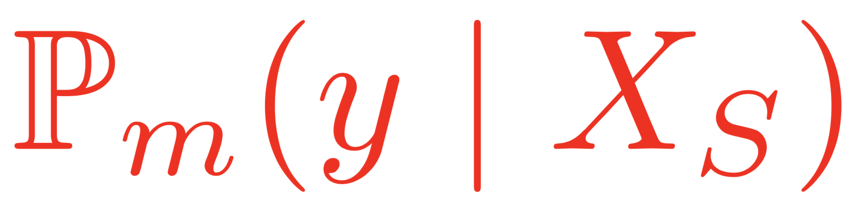
Intractability of the Objective
Intractable
hhh
Summing over all choices of S.

Slide 13
Approximations of the Objective
A variational lower bound
A neural network for parametrizing distributions
Continuous relaxation of subset sampling

Slide 14
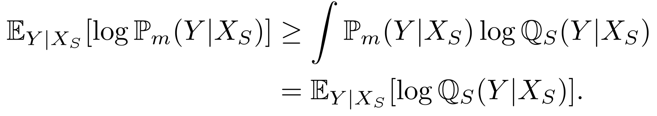
A Tractable Variational Formulation

Slide 15
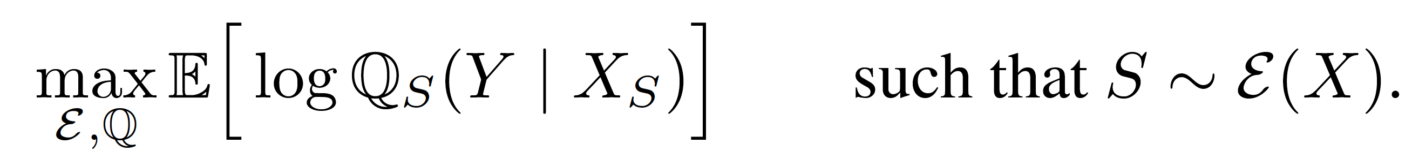
Maximizing Variational Lower Bound
Objective:

Slide 16

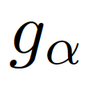
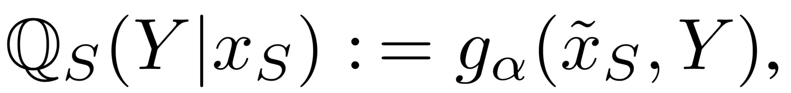
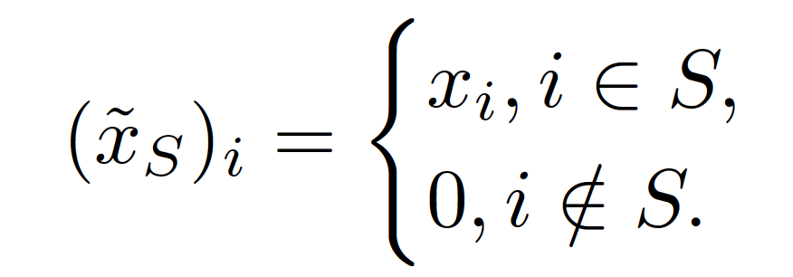
A single neural network for parametrizing
Parametrize by ,
such that

Slide 17
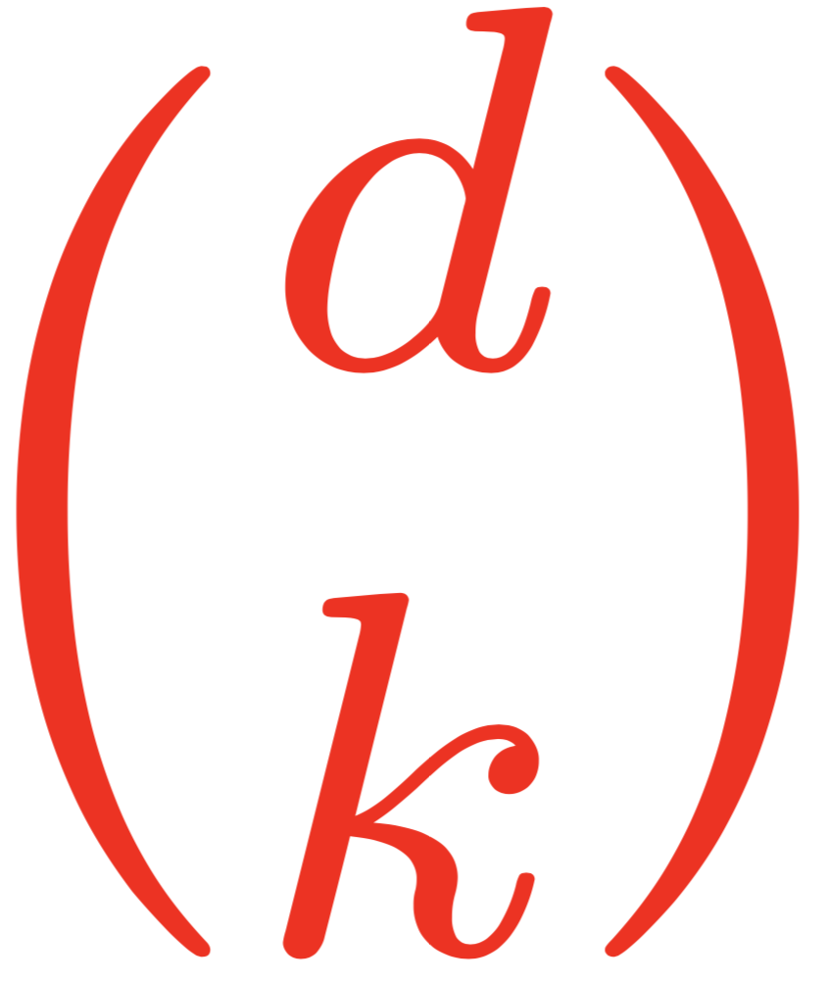
Summing over combinations

Slide 18
Continuous relaxation of subset sampling

Slide 19
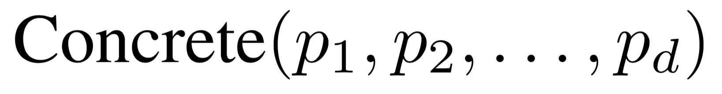
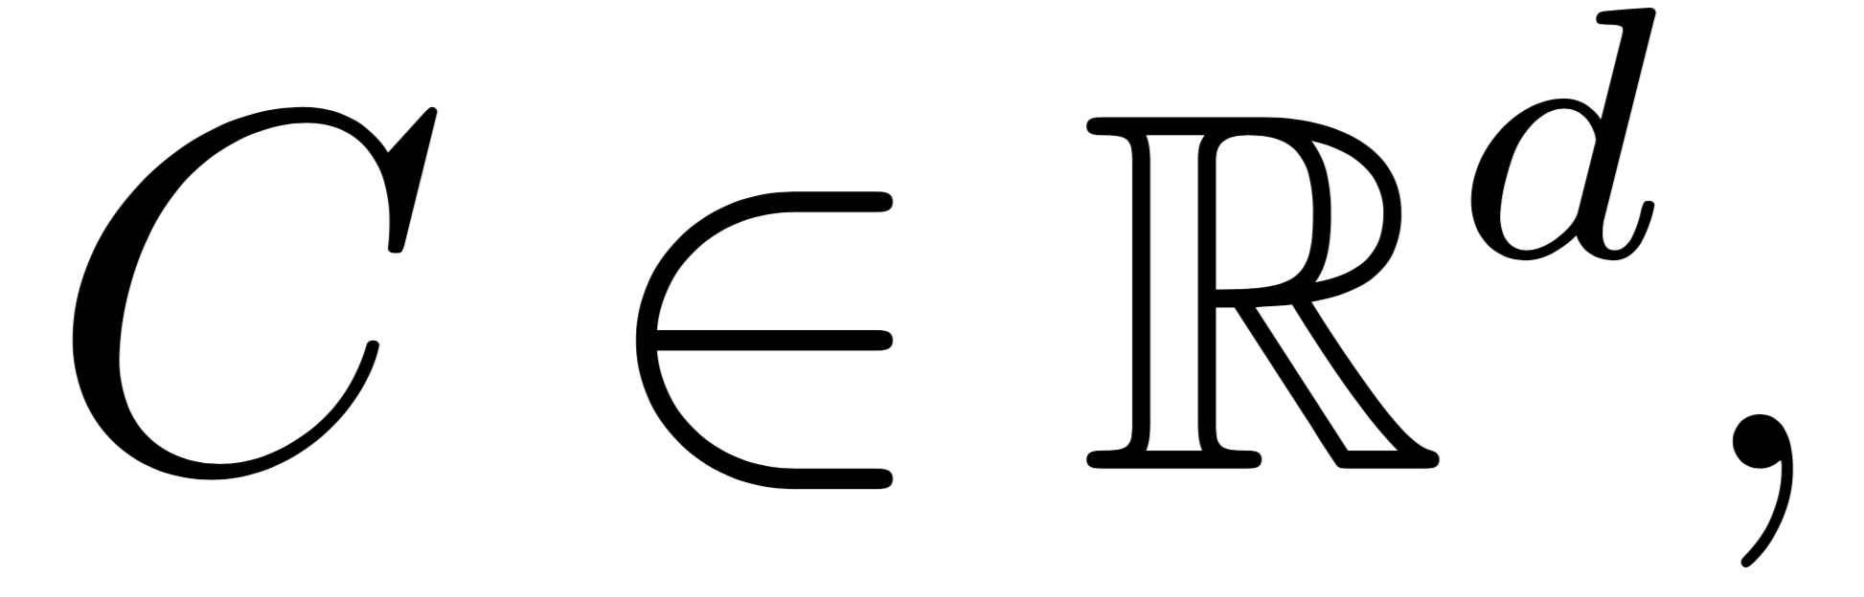
Continuous relaxation of subset sampling
:: : such that

Slide 20
Continuous relaxation of subset sampling
:: : such that
Approximation of Categorical:

Slide 21
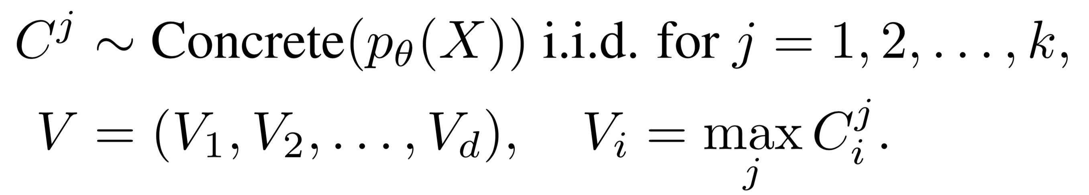
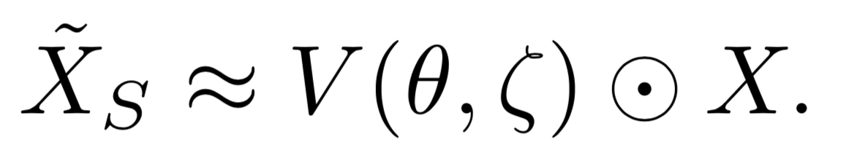
Continuous relaxation of subset sampling
:: : such that
Approximation of Categorical:
Sample k out of d features:

Slide 22
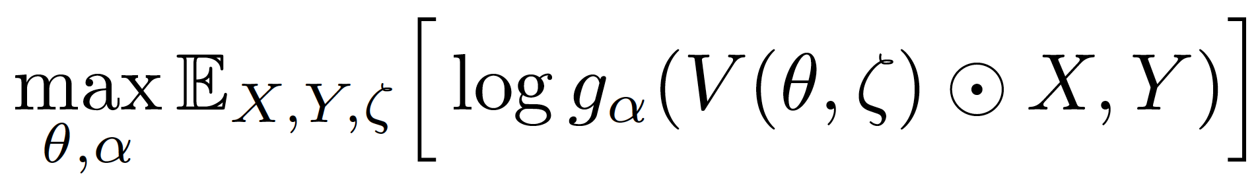


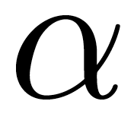
Final Objective
Reduce the previous problem
to
.
: Auxiliary random variables.
: Parameters of the explainer.
: Parameters of the variational distribution.

Slide 23
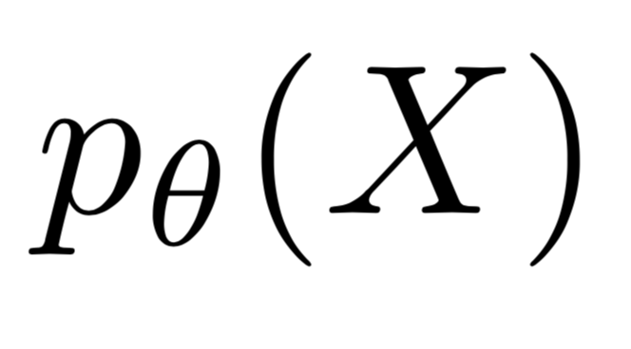
Explaining Stage
L2X
Training Stage
Use stochastic gradient methods to optimize the following:
Rank features according to the class probability .

Slide 24
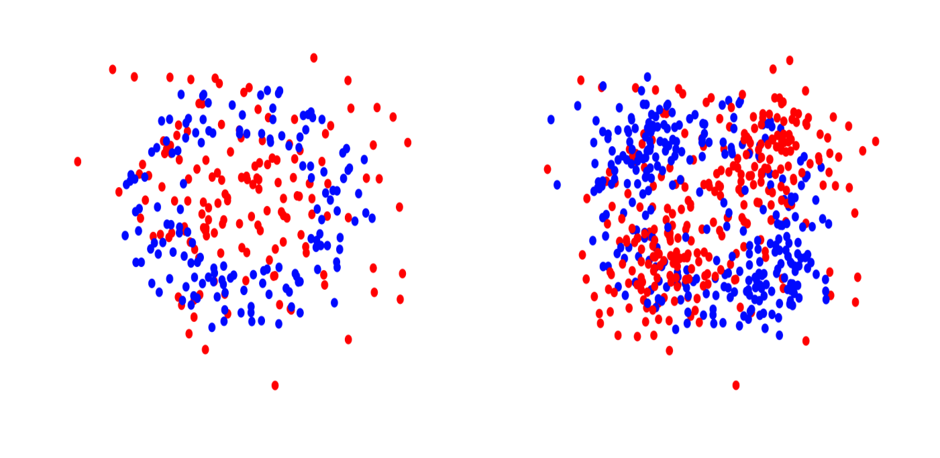
Synthetic Experiments
Orange Skin (4 out of 10)
XOR (2 out of 10)
Nonlinear additive model (4 out of 10)
Switch feature (Switch important features based on the sign of the first feature)

Slide 25
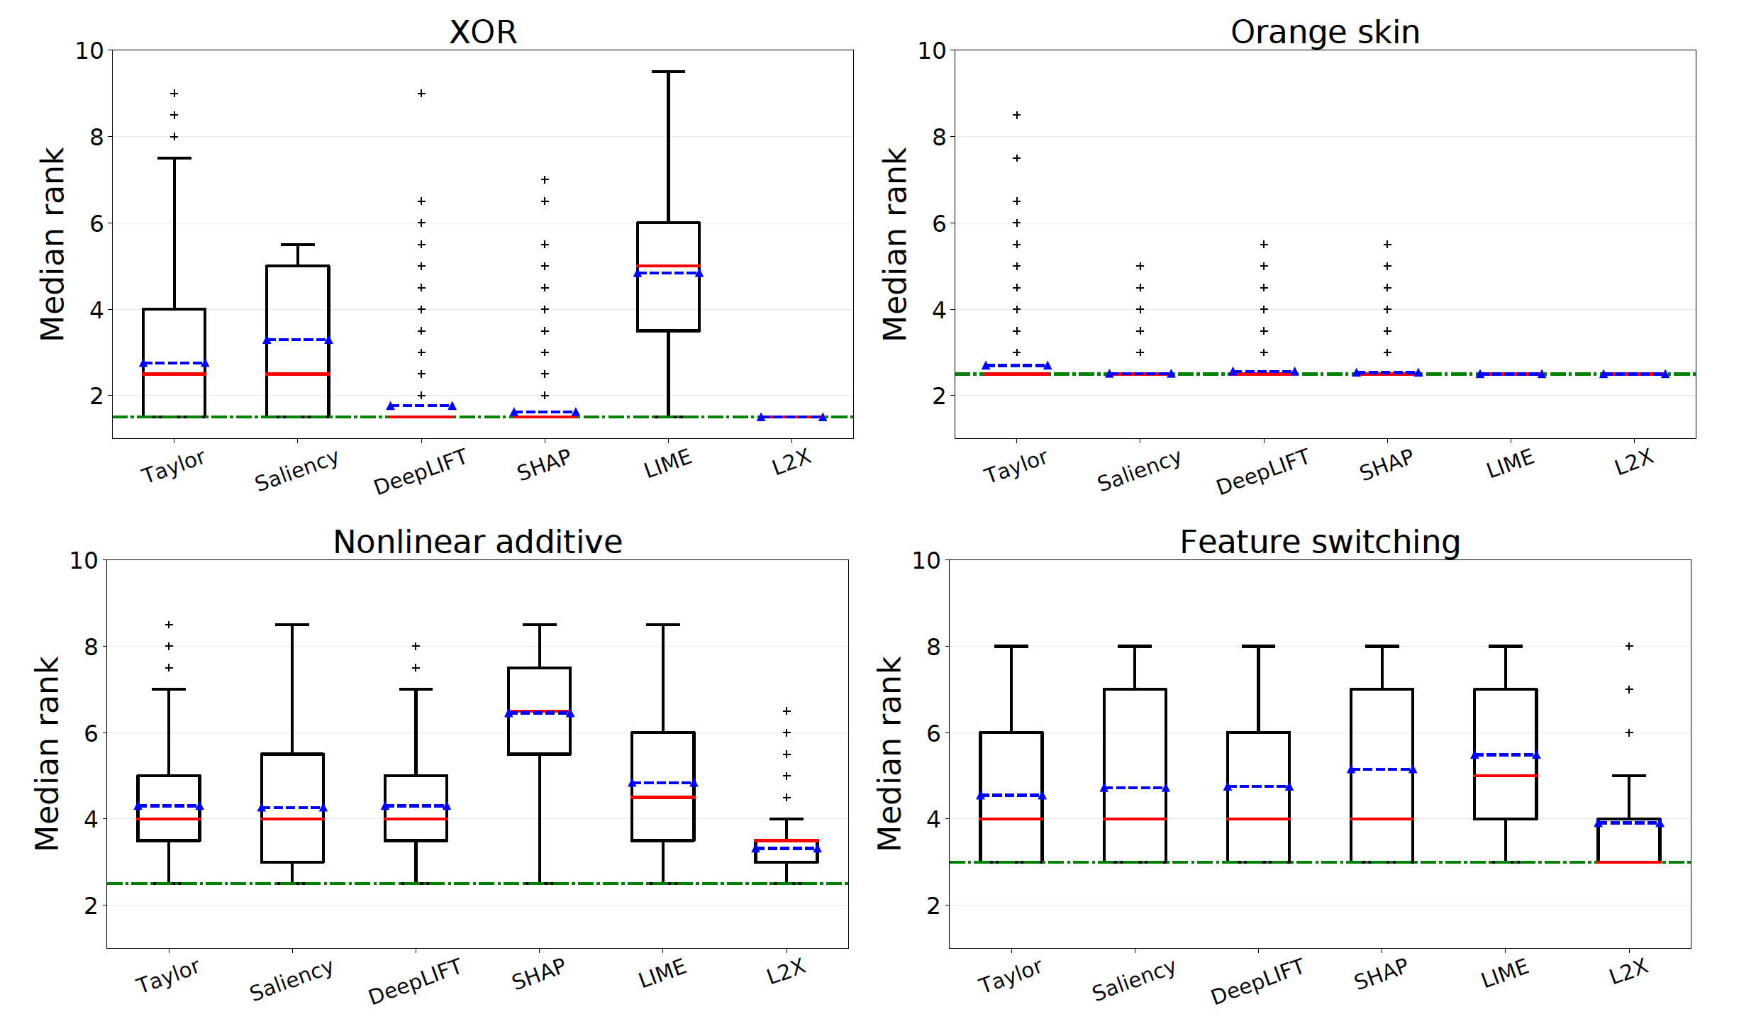
Median Rank of True Features

Slide 26
Time Complexity
The training time of L2X is shown in translucent bars.

Slide 27
Real-world Experiments
IMDB movie review with word-based CNN
IMDB movie review with hierarchical LSTM
MNIST with CNN

Slide 28
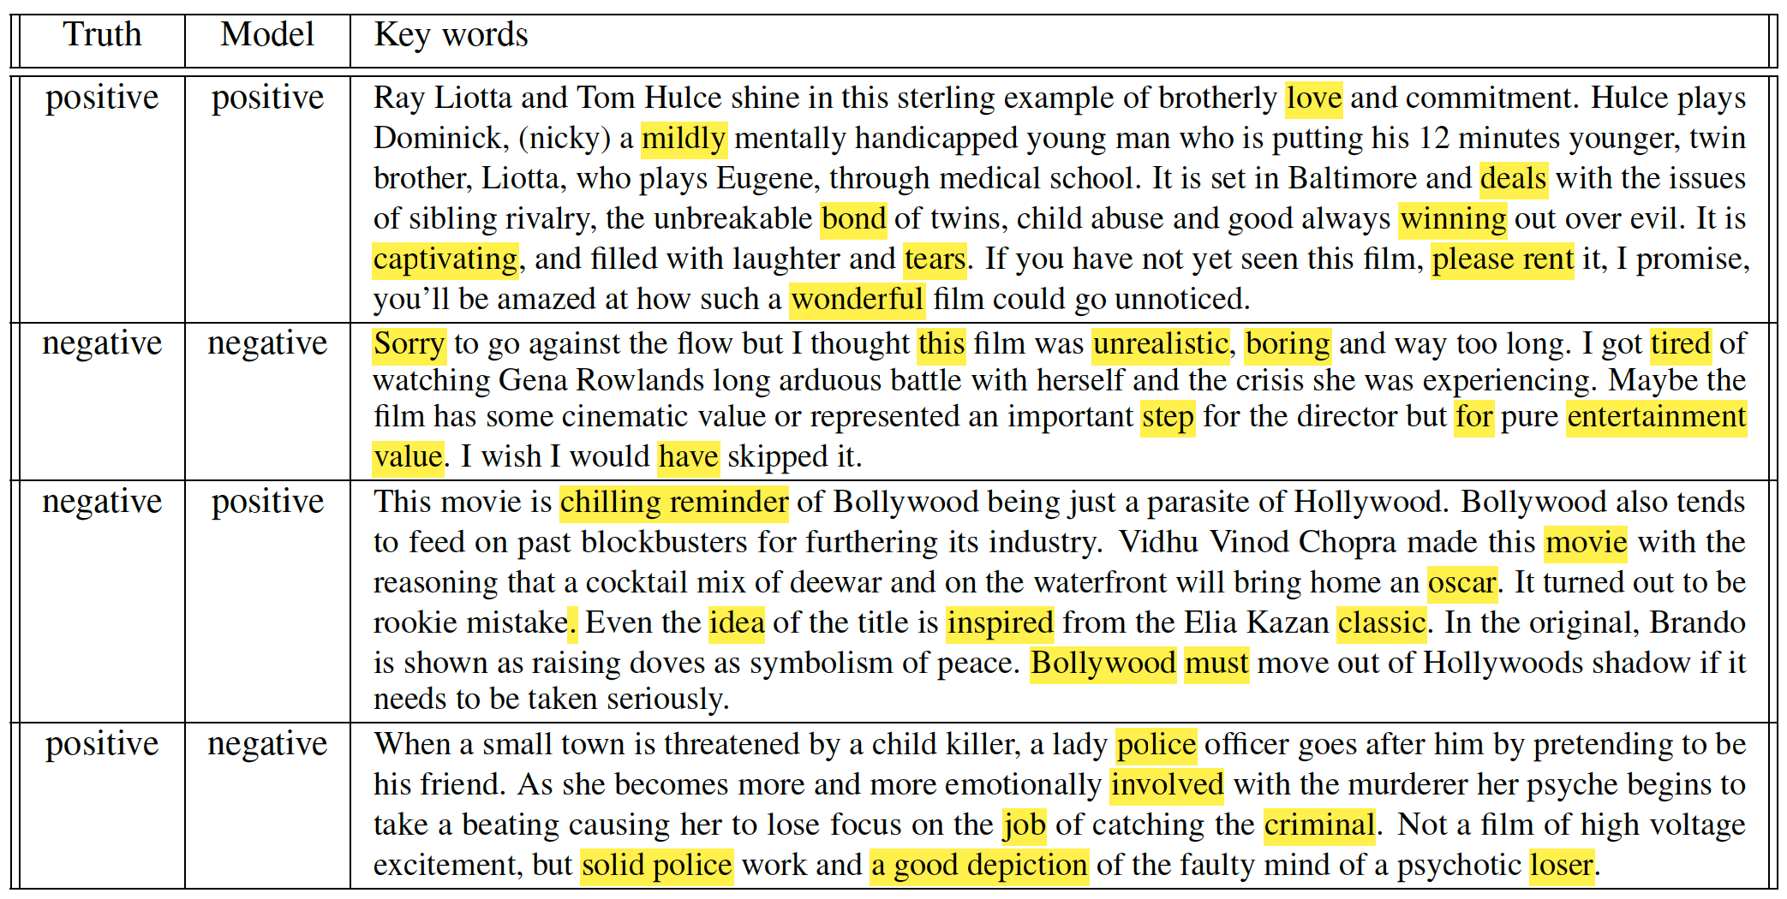
IMDB Movie Review with word-based CNN

Slide 29
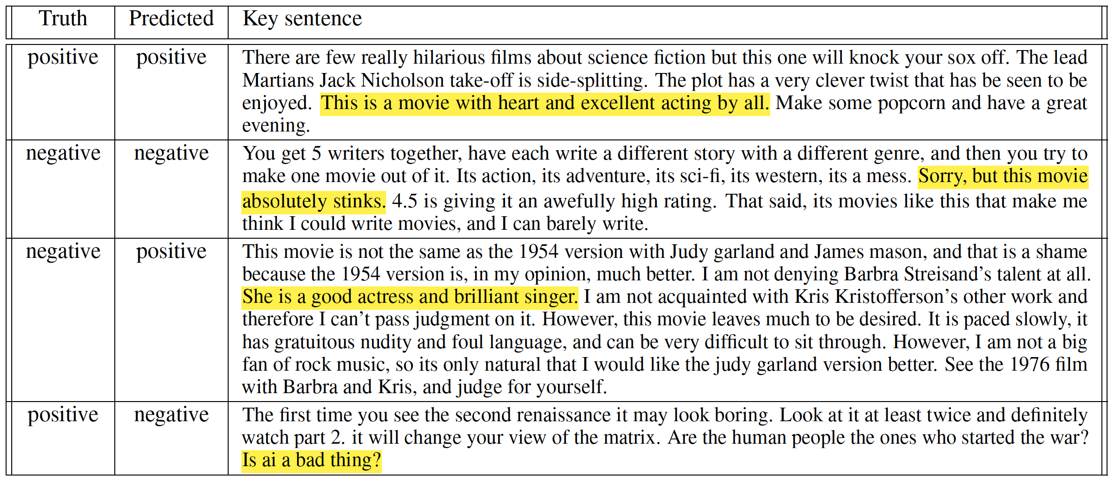
IMDB Movie Review with Hierarchical LSTM

Slide 30
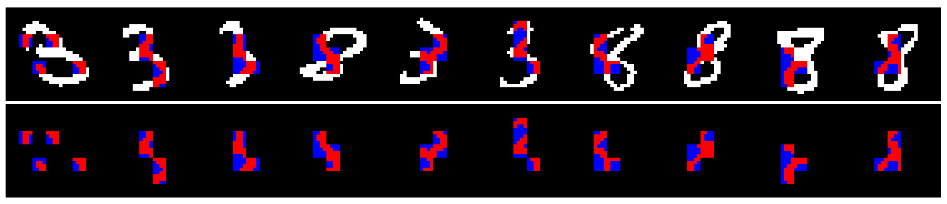
MNIST with CNN

Slide 31
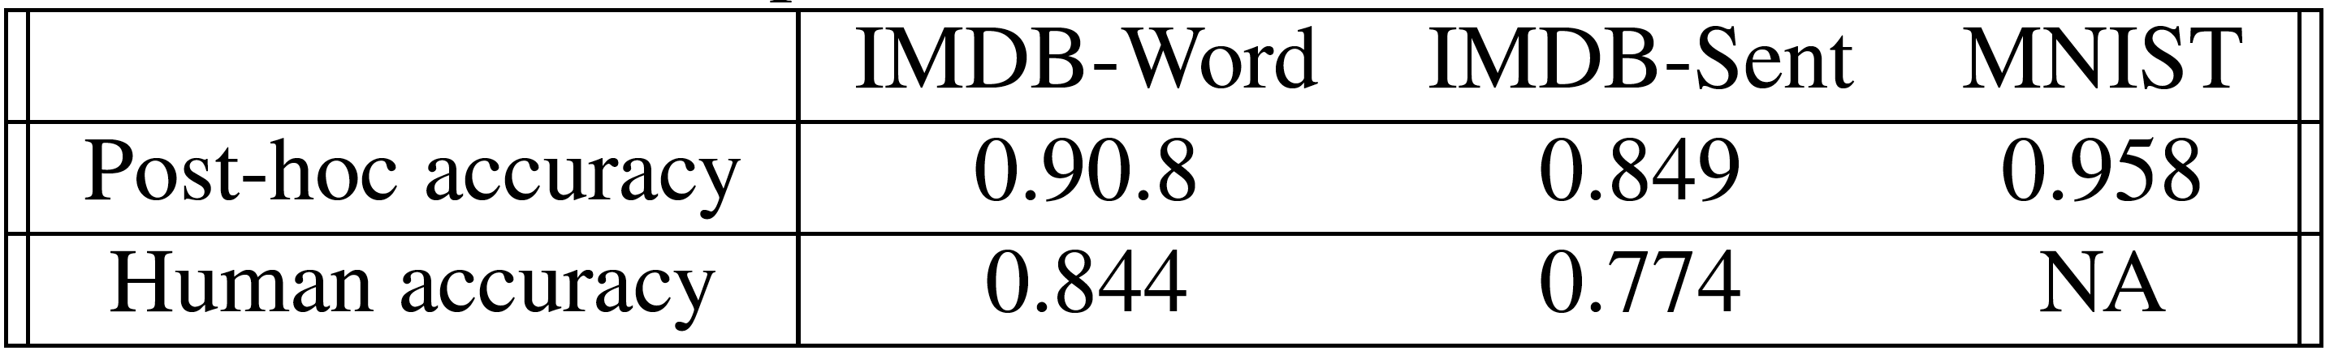
Quantitative Results
Post-hoc accuracy: Alignment between model prediction on selected features and on the full original sample.
Human accuracy: Alignment between human evaluation on selected features and the model prediction on full original sample.
Human accuracy given selected words: 84.4%
Human accuracy given original samples: 83.7%

Slide 32
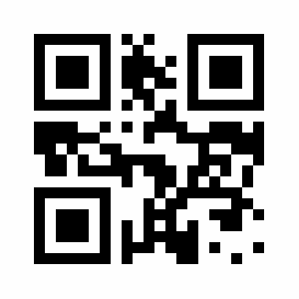
Links to Code and Current Work
Code: https://github.com/Jianbo-Lab/L2X
Generation of adversarial examples: https://arxiv.org/abs/1805.12316
Efficient Shapley-based model interpretation.
Poster: # 63

Slide 33
Learning to Explain:
An Information-theoretic Framework on
Model Interpretation
Jianbo Chen*, Le Song†✦, Martin J. Wainwright*◇ , Michael I. Jordan*
UC Berkeley*, Georgia Tech† , Ant Financial✦ and Voleon Group◇

