Slide 1
DAGGER: A sequential algorithm for FDR control on DAGs
Aaditya Ramdas, Jianbo Chen, Martin Wainwright, Michael Jordan

Slide 2
Problem and Settings
DAG is a directed graph with no directed cycles.
Each node represents a hypothesis.
Each directed edge encodes a constraint: a child is tested only if all of its parents are rejected.
Special cases: A tree; a line graph.

Slide 3
A Motivating Example

Slide 4
Why DAGs?
The process is sequential in nature. A discovery opens up new hypotheses (its children) to explore.
The process has a structural constraint for interpretability and logical coherence of the rejected set.

Slide 5
Related Work

Slide 6
Related Work
Jelle J Goeman and Ulrich Mansmann. Multiple testing on the directed acyclic graph of gene ontology. Bioinformatics, 24(4): 537-544, 2008.
Rosa J Meijer and Jelle J Goeman. Multiple testing of gene sets from gene ontology: possibilities and pitfalls. Briefings in bioinformatics, 17(5):808–818, 2015.
Rosa J Meijer and Jelle J Goeman. A multiple testing method for hypotheses structured in a directed acyclic graph. Biometrical Journal, 57(1):123–143, 2015.
Gavin Lynch. The Control of the False Discovery Rate Under Structured Hypotheses. PhD thesis, New Jersey Institute of Technology, Department of Mathematical Sciences, 2014.
Gavin Lynch and Wenge Guo. On procedures controlling the FDR for testing hierarchically ordered hypotheses. arXiv preprint arXiv:1612.04467, 2016.
Gavin Lynch, Wenge Guo, Sanat K Sarkar, and Helmut Finner. The control of the false discovery rate in fixed sequence multiple testing. arXiv preprint arXiv:1611.03146, 2016.

Slide 7
Related Work
Lihua Lei, Aaditya Ramdas, and Will Fithian. Interactive multiple testing: selectively traversed accumulation rules (star) for structured fdr control. in preparation, 2017.
Nicolai Meinshausen. Hierarchical testing of variable importance. Biometrika, 95(2):265-278, 2008.
Daniel Yekutieli. Hierarchical false discovery rate controlling methodology. Journal of the American Statistical Association, 103(481):309-316, 2008.
Barber, Rina Foygel, and Aaditya Ramdas. The p-filter: multi-layer FDR control for grouped hypotheses. arXiv preprint arXiv:1512.03397 (2015).
Eugene Katsevich, et al., Multilayer False Discovery Rate Control for Variable (2017).
Marina Bogomolov, Christine B. Peterson, Yoav Benjamini, Chiara Sabatti. Testing hypotheses on a tree: new error rates and controlling strategies. arXiv:1705.07529 (2017).
Aaditya Ramdas, Rina Foygel Barber, Martin J Wainwright, and Michael I Jordan. A unified treatment of multiple testing with prior knowledge. arXiv preprint arXiv:1703.06222, 2017.

Slide 8
Notations on DAGs
Par(a): the set of parents of node a.
Depth(a): The length of the longest possible path from a root to the node +1.
$l_{a}$: Effective number of leaves at each node a.
$m_{a}$: Effective number of nodes at each node a.

Slide 9
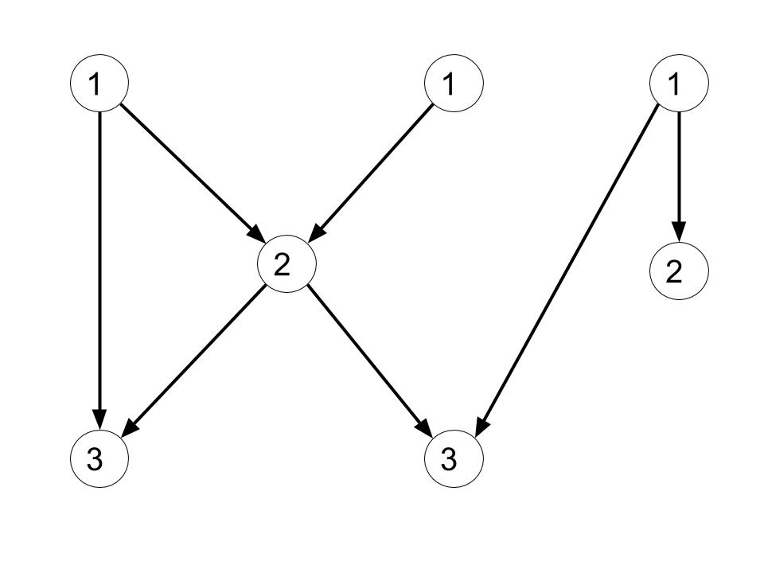
Depth
Depth(a): The length of the longest possible path from a root to the node +1.
All roots has depth 1.
$Depth\left(a\right)=1+\max_{\left\{b∈Par\left(a\right)\right\}}{Depth\left(b\right).}$

Slide 10
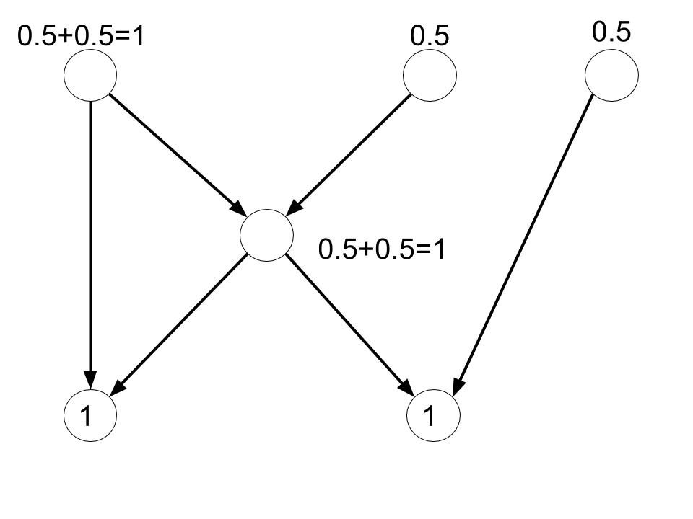
Effective number of leaves
Calculated in a bottom-up fashion.
At each leaf node a, $l_{a }$= 1.
Proceeding up the tree, $l_{a}= \sum_{b∈Child(a)}{\frac{l_{b}}{|Par(b)|}}$

Slide 11
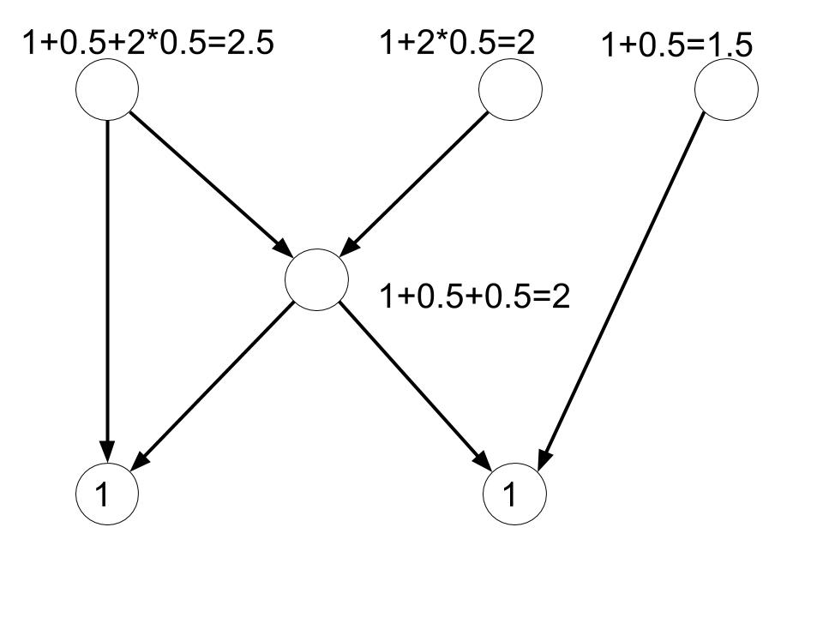
Effective number of nodes
Calculated in a bottom-up fashion.
At each leaf node a, $m_{a }$= 1.
Proceeding up the tree, $m_{a}=1+ \sum_{b∈Child(a)}{\frac{m_{b}}{|Par(b)|}}$

Slide 12
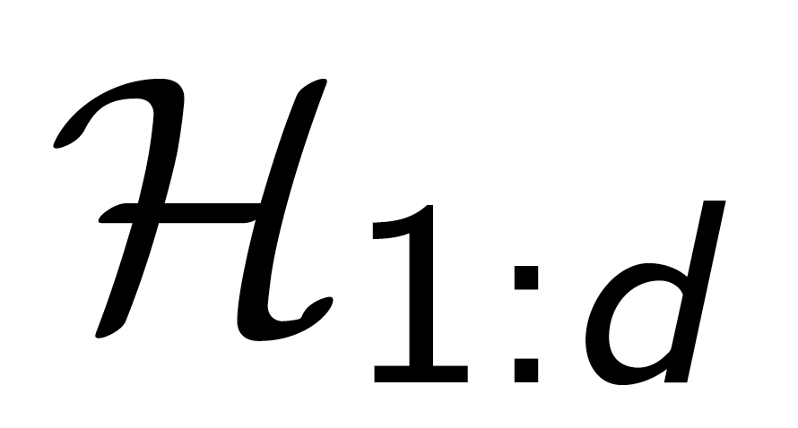
Notations on Hypotheses
denotes the set of all hypotheses at depth d.
denote their corresponding p-values.
denotes the set of all nodes with depth <= d.

Slide 13
Assumptions
Under null, each p-value is super-uniform: For any $t∈\left[0,1\right]$, we have $Pr\left\{P≦t\right\}≦t$.
The p-values are independent or positively dependent (PRDS). (Will be generalized later.)

Slide 14
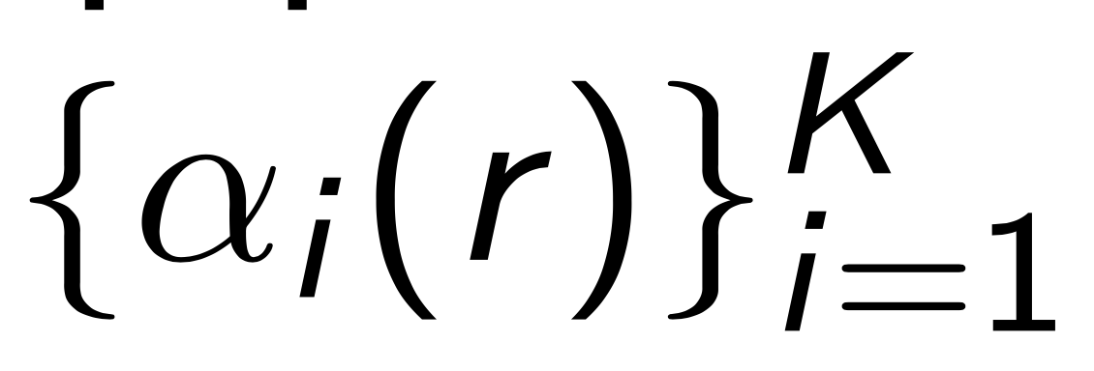
Generalized Step-up Procedure (GSU)
A generalized step-up procedure associated with a sequence of threshold functions ,with
Reject all i such that
For example, the BH procedure is recovered by using for all i.

Slide 15
DAGGER (Independent or PRDS)

Slide 16
An example

Slide 17
An example

Slide 18
An example

Slide 19
An example

Slide 20
An example

Slide 21
Special cases
Tree: Lynch and Guo [2016]
Sequence: Lynch et al. [2016]
No edges: Benjamini and Hochberg [1995]

Slide 22
Arbitrary dependence
Define a reshaping function:

Slide 23
DAGGER (Arbitrary dependence)

Slide 24
FDR Guarantee
Theorem: The GSU-DAG procedure guarantees that FDR ≤ α.

Slide 25
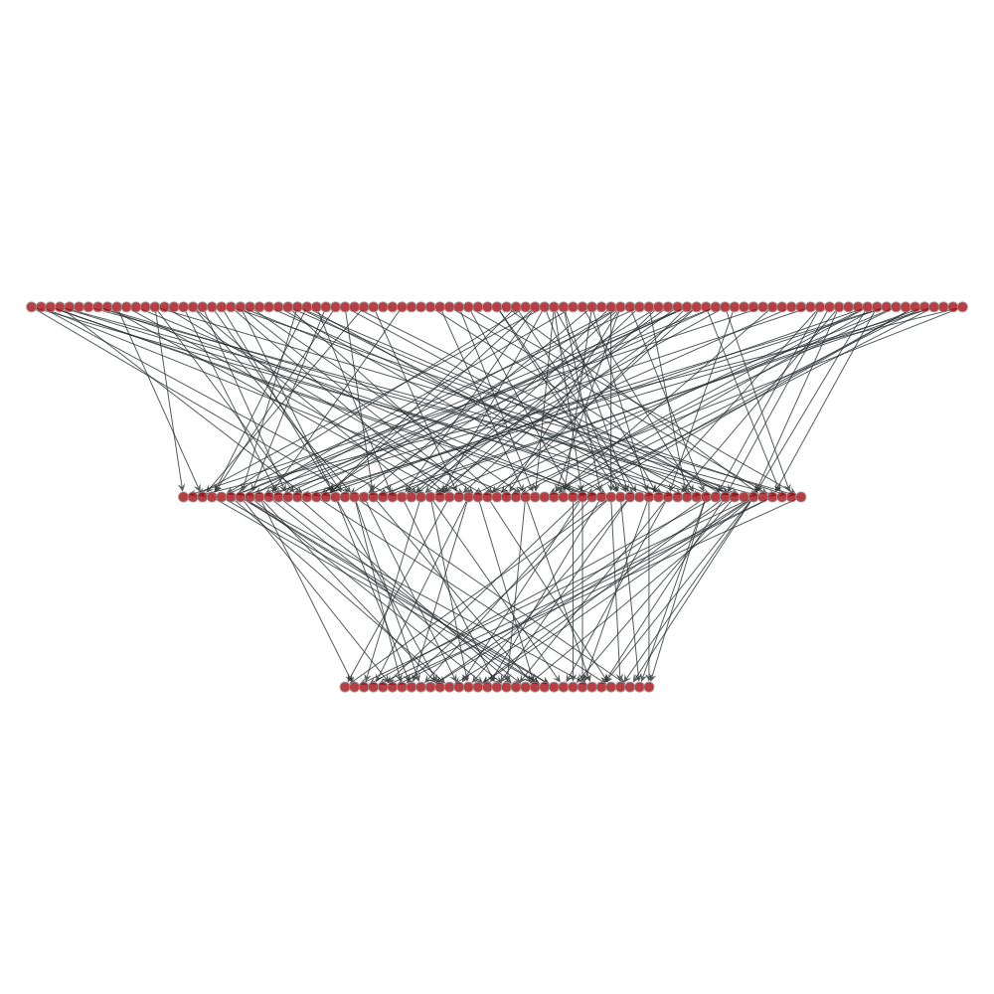
Mountain v.s. Valley

Slide 26
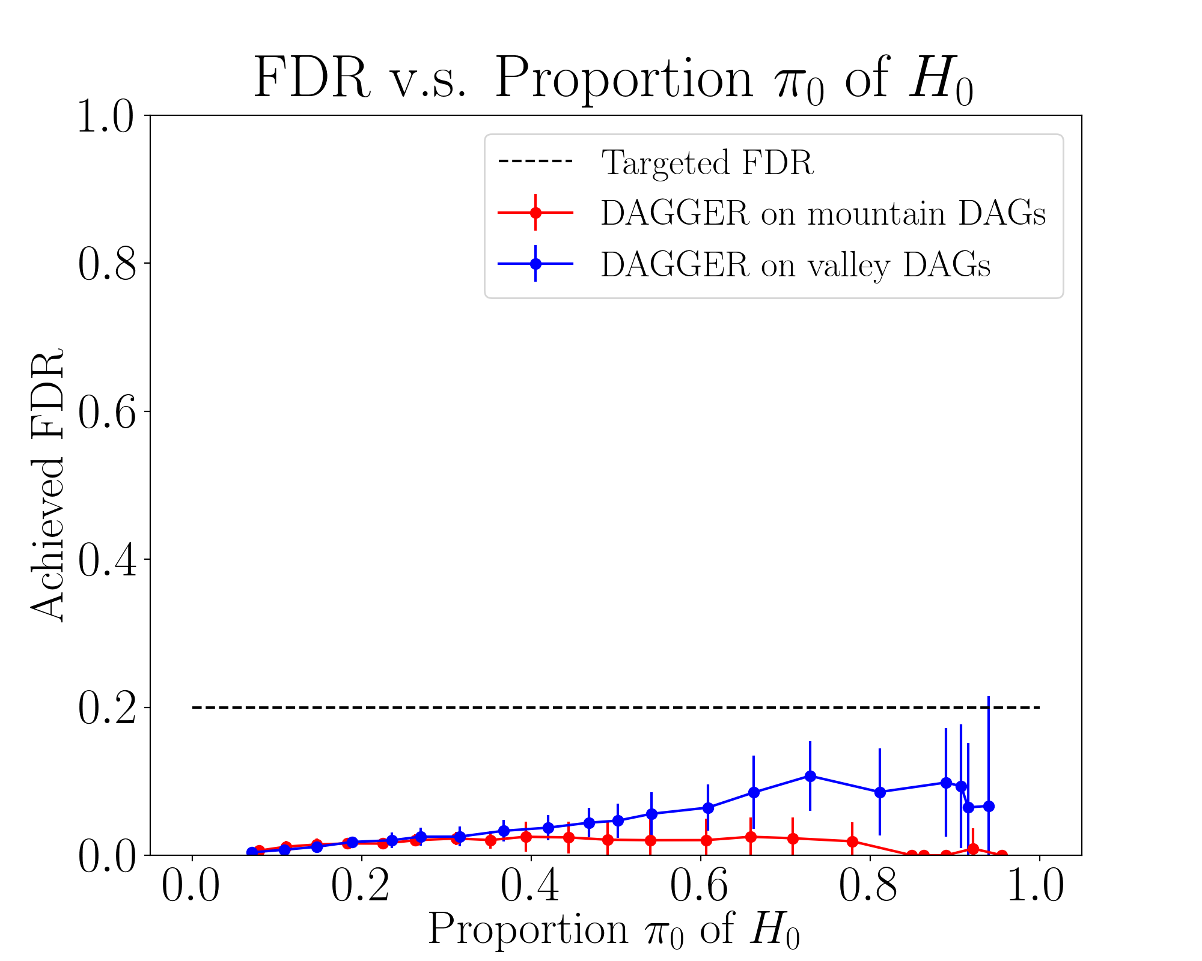
Mountain v.s. Valley

Slide 27
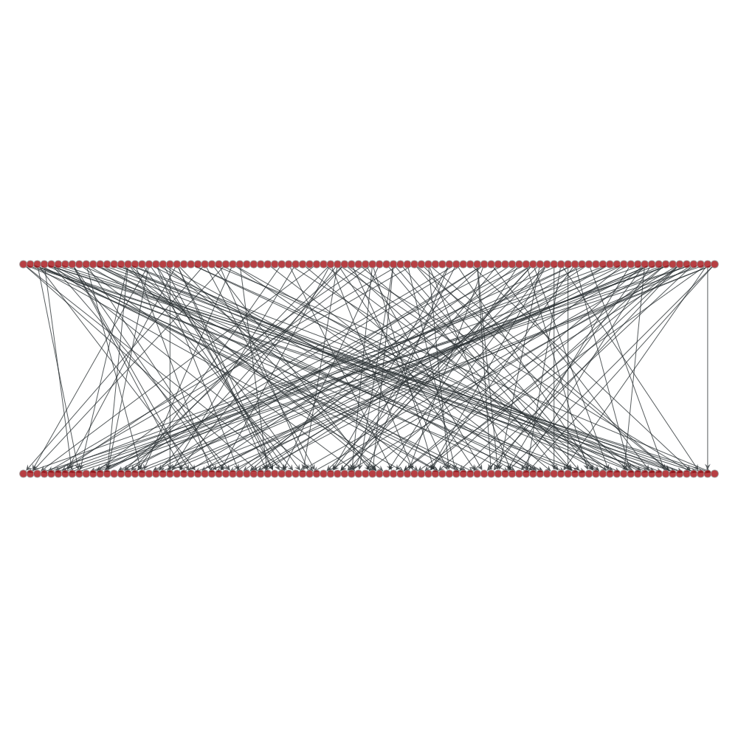
Shallow v.s. Deep

Slide 28
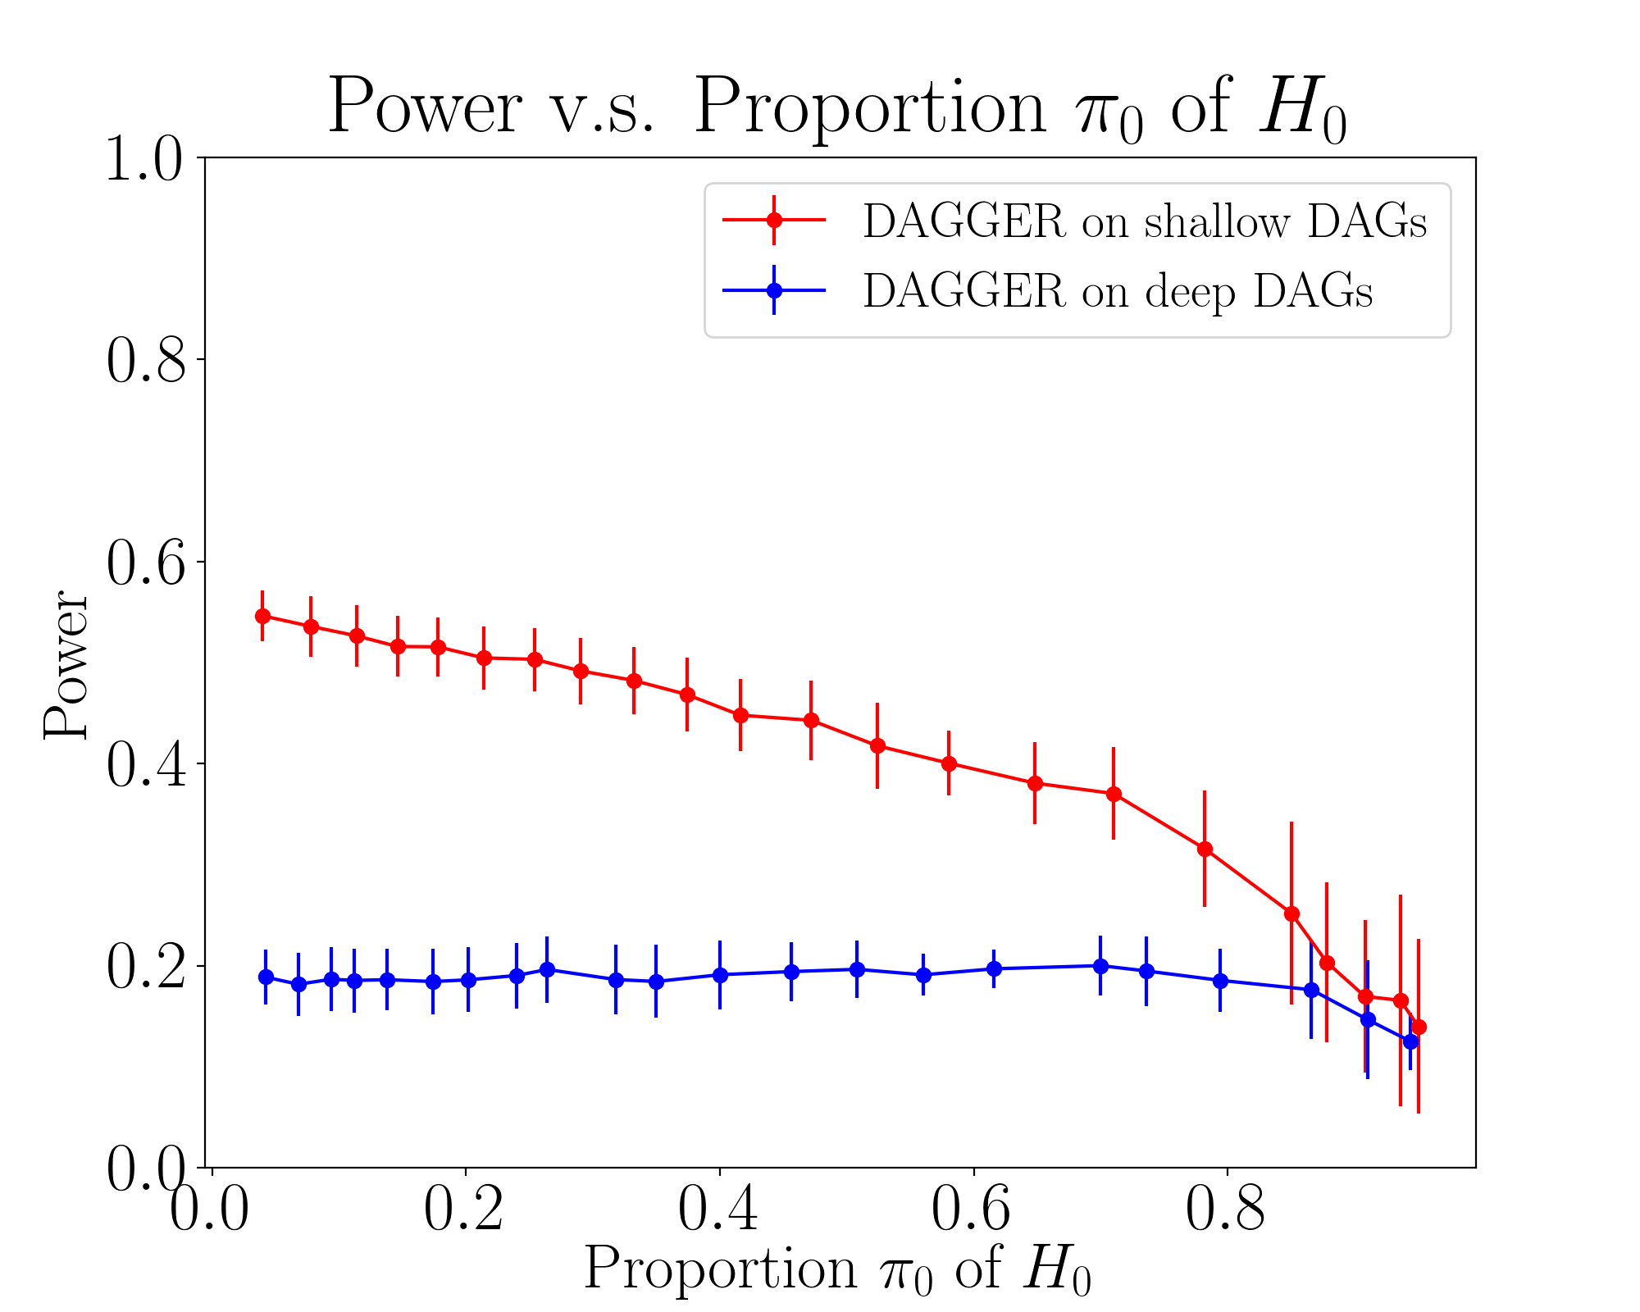
Shallow v.s. Deep

Slide 29
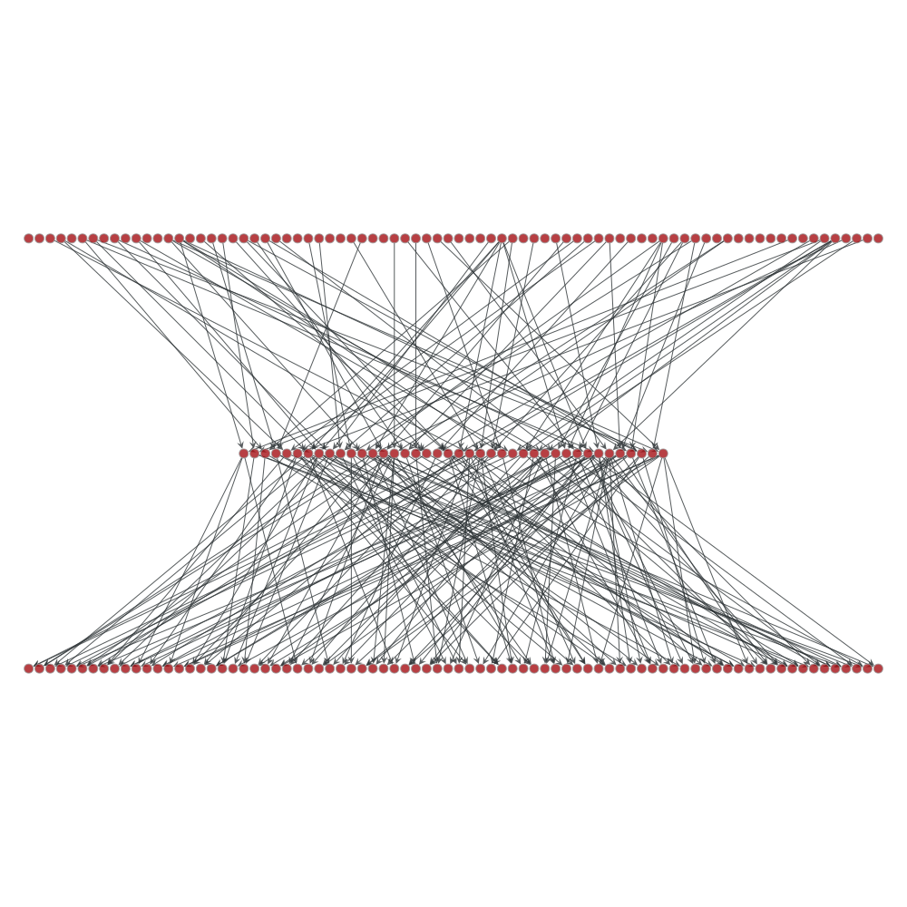
Hourglass v.s. Diamond

Slide 30
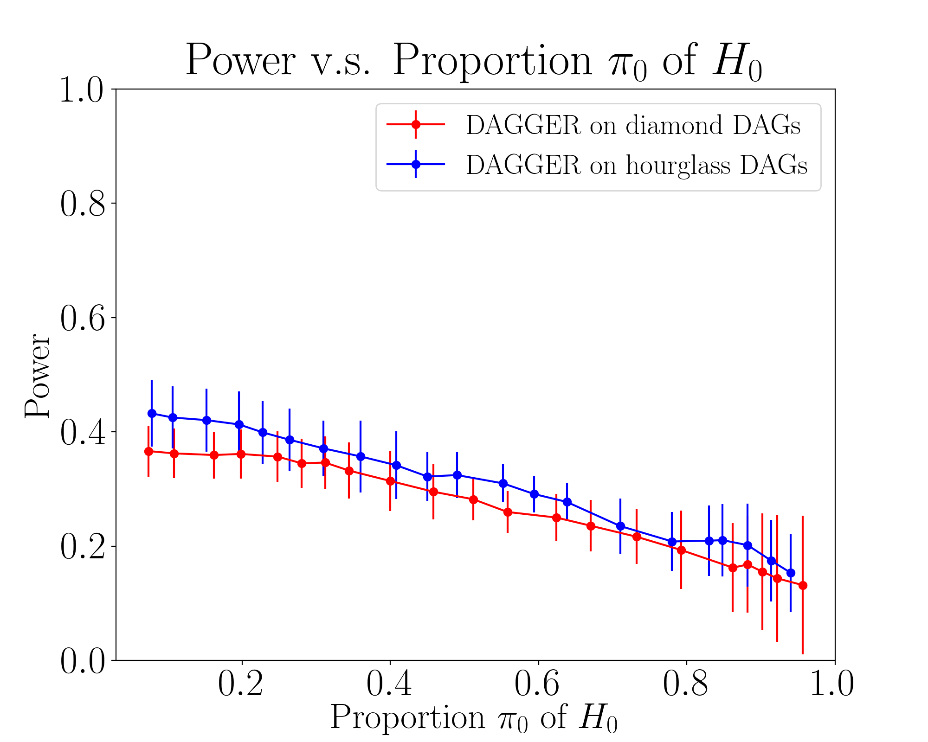
Hourglass v.s. Diamond

Slide 31
Comparison with other algorithms
Graph Structures: the Gene Ontology (GO); its subgraph.
Distribution of nulls and alternatives: randomly generated on leaves, hypotheses in the upper layers are distributed according to the logical constraints.
P-values: independent; Simes.

Slide 32
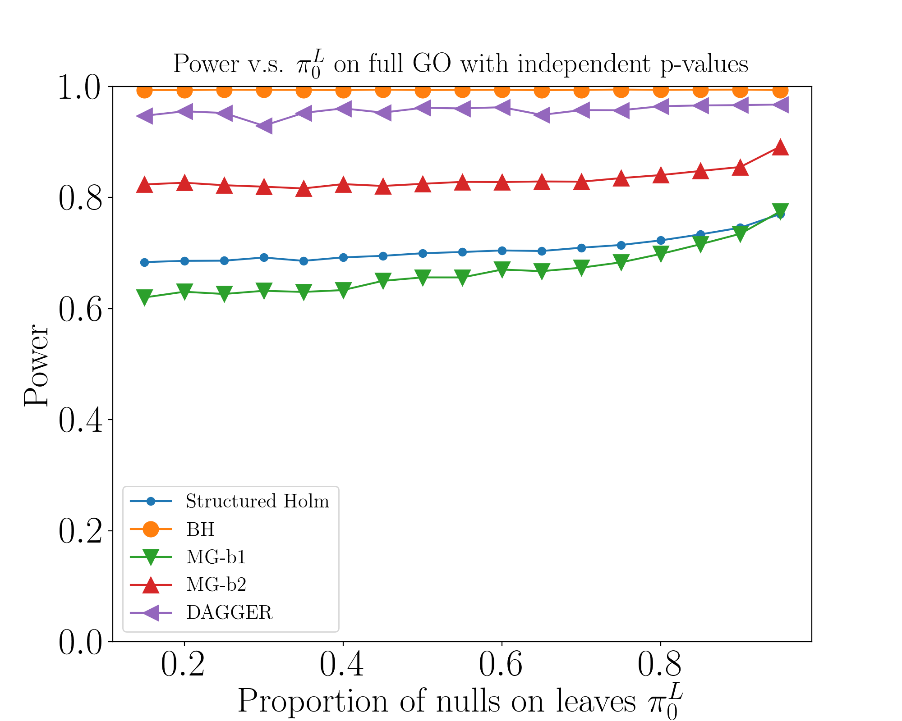
Power for independent p-values

Slide 33
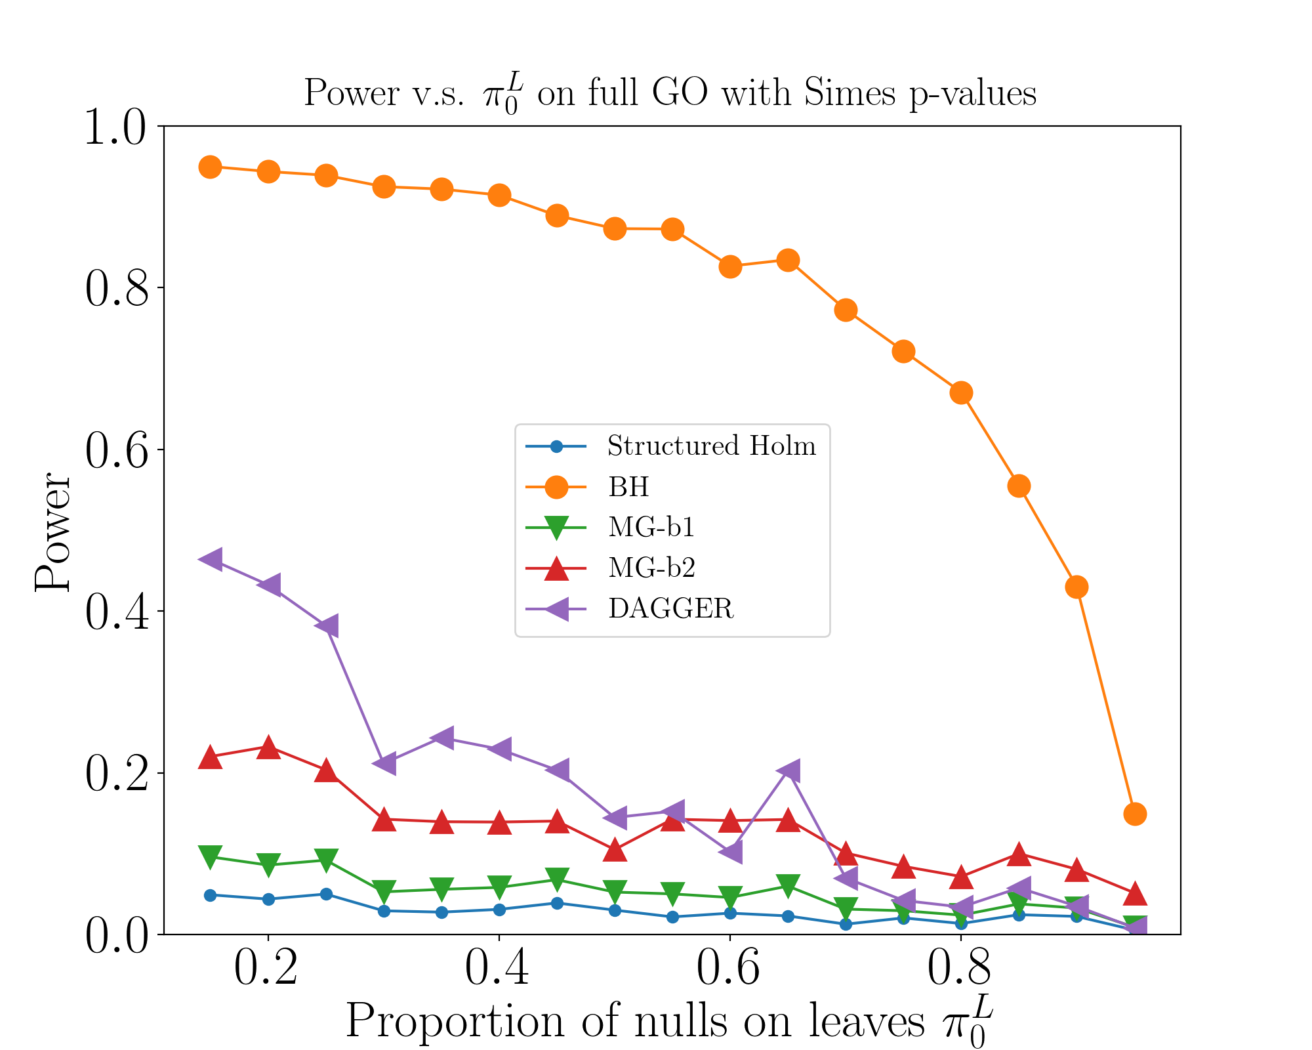
Power for Simes p-values

Slide 34
Time Complexity

Slide 35
Applications
The Gene Ontology graph represents a partial order of the GO terms. Each node represents a set of genes annotated to a certain term, and the set is a subset of those annotated to its parent node.
Golub data set is from the leukemia microarray study, recording the gene expression of 47 patients with acute lymphoblastic leukemia and 25 patients with acute myeloid leukemia.
Null: No gene in the set corresposnding to the node is associated with the type of diseases.
Individual (raw) p-values are obtained by Global Ancova.

Slide 36
Results
Green, red, yellow nodes are rejections made by both algorithms, GSU-DAG alone and Focus Level alone respectively at α = 0.001.

Slide 37
Results
Table: The comparison of the number of rejections from GSU-DAG and from Focus Level methods with different α-levels. The numbers in parentheses are the number of rejections on leaves.

Slide 38
Authors

